Slide 1
Quantitative Methods in HSR I
Lecture 1: Understanding the Determinants of Health Outcomes:
DAGs and Potential Outcomes
January 5, 2026
HAD5744 • Alex Hoagland, Ph.D.
Notes:
Let’s start with a round of introductions – name, which program you’re in (Msc/Phd + emphasis + 1 broad/specific area of research interest), anything else you want us to know.

Slide 2

Introductions
Notes:
Some of my “get to know you” answers:

Slide 3
Introductions: Backgrounds
Worked as research analyst at UHN for 2 years.
I'm a practicing nurse practitioner (NP) that specializes in liver disease at University Health Network (UHN), focused primarily in cirrhosis and liver failure. I have worked in healthcare for over 17 years, and am hoping to translate my clinical experiences into work that has more systems-level impact as my career evolves.
I currently don't know what I want to do with my degree but I know that I am very interested in using healthcare data to drive informed decision making to improve the health outcomes, and experience within the healthcare systems of individuals and populations
I am an epidemiologist, and have worked in several research/hospital research institutes. I’m currently working full-time as a Senior Analyst at CIHI.
I am a pharmacist who has been working as a consultant in the pharmaceutical industry, primarily working on real-world evidence generation and preparing HTA submissions.
Notes:
Some of your answers to the survey (if you haven’t taken it, please do! For my own info at least). We have both Master’s and PhD students with all kinds of interests (here are just a few – can remain anonymous if desired). Lots of different backgrounds and comfort working with data + research questions + contexts. Good scope for group work here!

Slide 4
Introductions: Goals from Course
Doing multidisciplinary research on AI for applications in healthcare
Learn the statistical and quantitative analysis skills that will be used in my thesis analysis.
Enhance research and appraisal skills relevant to clinical academic medicine, with the goal of focusing on health policy/systems level "quality improvement"
I am passionate about understanding health inequities and improving the quality of life of marginalized people (especially people with disabilities).
I hope there will be a balance between learning the theoretical underpinnings and their practical application - I'm looking forward to the 'hands on' aspect of moving beyond understanding the statistical analysis in theory, to being able to apply it myself in R.
Notes:
Lots of different professional and academic goals!
Now, a couple of things we’re *not* doing, just for transparency – if you want me to direct you to other courses where you can find these, I can absolutely do that:
Clinical trials (ish) (things like calculating power, planning them, etc.)
Meta analysis and systematic reviews
Economic evaluation (e.g., for a drug; CEA, CUA)
Survey design or implementation

Slide 5
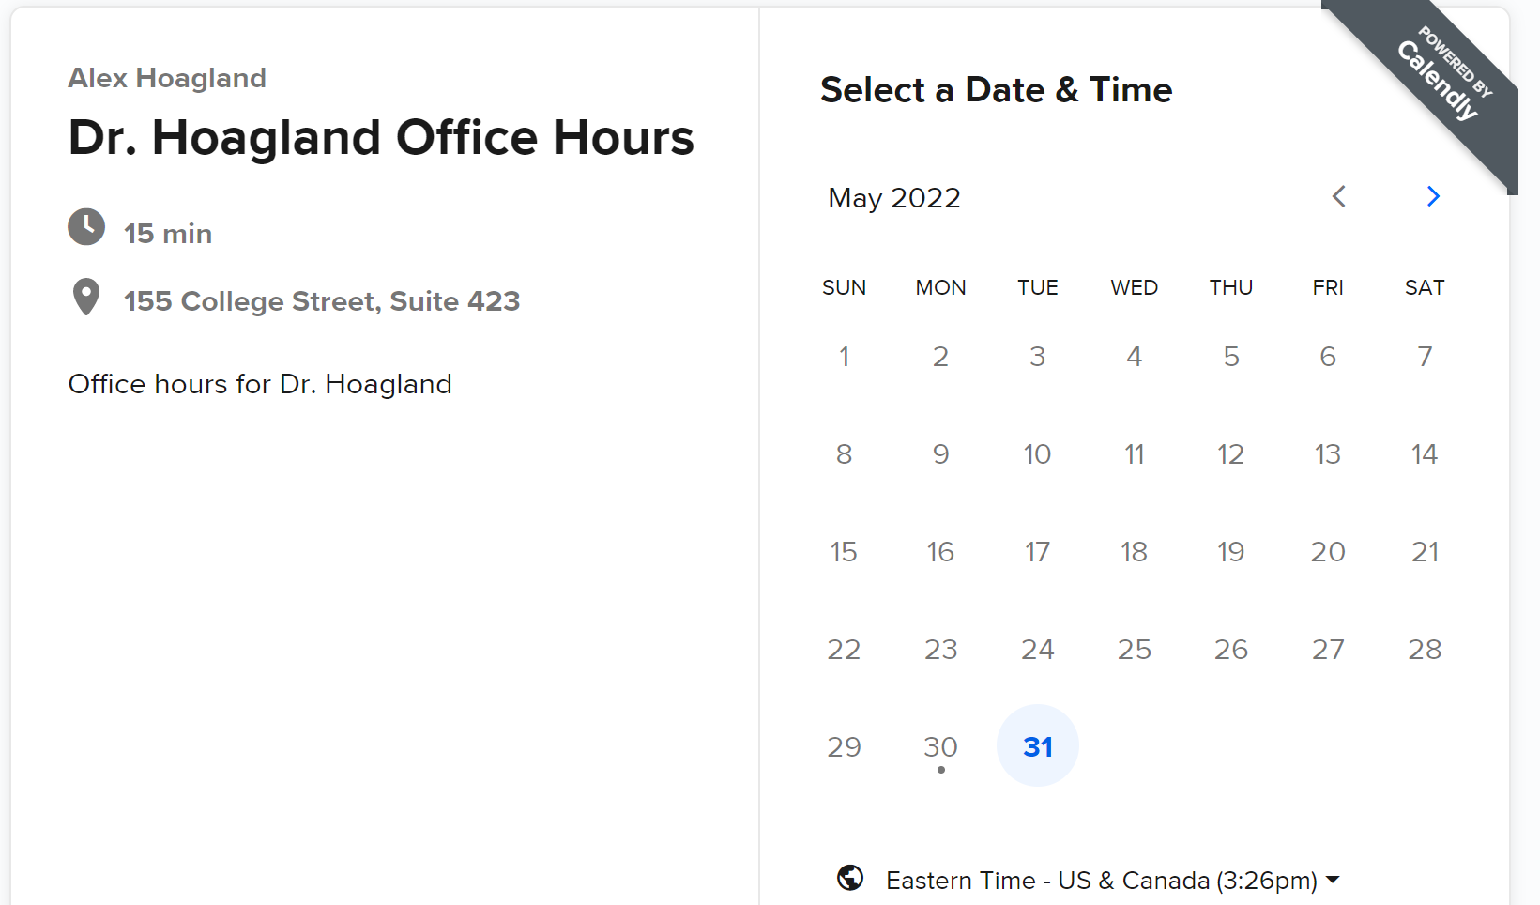
Introduction & Syllabus
Booking office hours: calendly.com/Hoagland-office-hours/
Tuesdays, 9-11am, or by appointment.
All appointments are by Zoom unless arranged otherwise in advance.

Slide 6
Introduction & Syllabus
Evaluation Criteria (40% of total grade)
Assignments: 4 assignments, each worth 10% of the final grade.
Please submit by Quercus before class on the due date
A complete assignment should be a knitted document containing code and output – can use code appendices if you’d like for formatting
Assignments should be submitted as a group (one document per group)
Notes:
Try knitting early and often – want to make sure you’re not just coding away in an environment that isn’t going to respond to you.

Slide 7
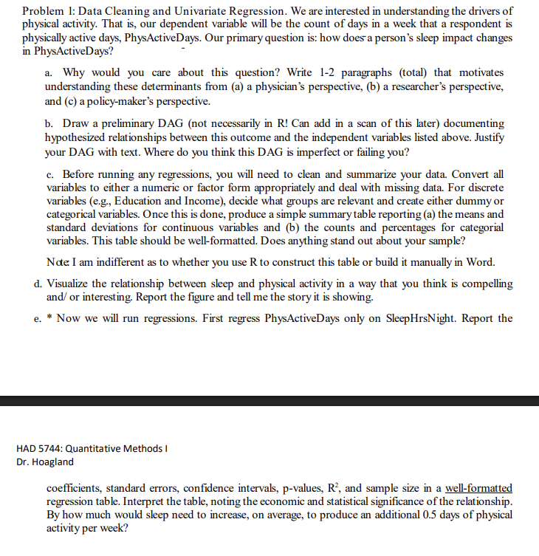
Introduction & Syllabus
Evaluation Criteria (40% of total grade)
Assignments:
Assignments should be seen less as math homework, more as paper skeletons you should fill in (use to practice academic writing!)
Notes:
Example here is Assignment 1 – you should think about answering all of the questions as getting you to a B+/A- or so. The academic writing and how we discuss these issues is a central part of this course, and so will constitute a chunk of the grade (we will talk about grading later).

Slide 8
Introduction & Syllabus
Evaluation Criteria
Assignments: 4 assignments, each worth 10% of the final grade.
Please submit by Quercus before class on the due date
A complete assignment should be a knitted document containing code and output
Notes:
Assignments may (should!) be done in groups of 2-5 students; group assignment on Quercus (one copy per group)
Each assignment should have a “Contribution statement” outlining each group member’s contributions, mutually agreed upon by the group members.
Generative AI in Course Content and Materials: Use it, don’t trust it!
For each assignment, include a paragraph explaining (a) how these tools were used and (b) how you as the student integrated these materials into your assignment (e.g., how were the inputs checked for completeness or debugged?).
I will be using Pangram to check for AI-generated output. Too much of this, especially if it conflicts with your statement, may impact your overall mark.
There is a 10 (percentage point) penalty for each late day.
Notes:
Parts of the assignment drawn straight from ChatGPT with insufficient checks/editing will be deducted points (including a 0 score for AI without any changes).

Slide 9
Assignment Presentations
25% of assignment marks (10% of overall grade) come from recorded video presentations of assignment solutions.
These must be submitted individually.
For each assignment, you will be asked to record videos of no more than 3 minutes explaining how you arrived at the answer to a given problem. You should explain both the code you used as well as how you interpreted your results. If applicable, you may also discuss how you would extend your findings in an actual research setting.
These videos should be submitted on Quercus in a MP4, AVI, WMV, or MOV format.
Notes:
This isn’t just to get around Chat GPT (although that’s a bit motivator). It’s also because graduate level skills involve being able to cogently, precisely, and pithily explain your reasoning and work as well as actually doing the work. The conversation is just as important as the code.

Slide 10
Introduction & Syllabus
Evaluation Criteria (60% of total grade): Your choice of:
2 Referee Reports (30% each)
Major Paper (must choose this if you are in the PhD program)

Slide 11
Introduction & Syllabus
Evaluation Criteria (60% of total grade): Your choice of:
2 Referee Reports (30% each)
Major Paper (must choose this if you are in the PhD program)
Referee Reports:
Critical evaluation of a recent HSR paper
Evaluating statistical (internal) validity and causal inference techniques
Provide suggestions for improvement and future work
Paper options are on GitHub
You must select papers from two different topics.
Reports are due one week after the topic has been covered in class.

Slide 12
Introduction & Syllabus
Evaluation Criteria (60% of total grade): Your choice of:
2 Referee Reports (30% each)
Major Paper (must choose this if you are in the PhD program)
Major Paper: Investigation of a research question of your own choosing
Pair up in groups of 2-5 to produce a paper.
Research question & paper structure should match your emphasis but incorporate methods learned in this course
Follow structure of a leading journal
It must also include a contribution statement listing each author’s unique role in producing the final project, agreed upon by all project team members.
Notes:
NO solo projects, unless a clear reason for an exemption is granted. Also, note that your paper must integrate one of the strategies from the second half of the class to earn at least an “A”, so you may want to plan ahead. And talk to me early!

Slide 13
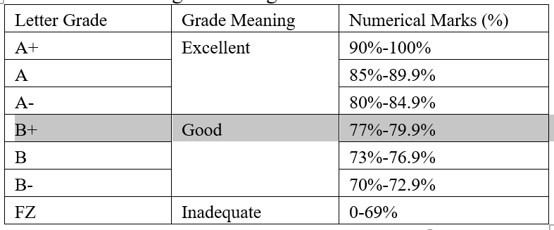
Grading Policy
What do my grades mean?
Excellent: Strong evidence of original thinking; good organization; capacity to analyze and synthesize; superior grasp of subject matter with sound critical evaluations; evidence of extensive knowledge base.
Good: Evidence of grasp of subject matter, some evidence of critical capacity and analytic ability; reasonable understanding of relevant issues; evidence of familiarity with literature.
Notes:
Note that we are attempting to standardize grades across courses with the modernization, so some of this is updated department policy. What does each grade mean?
A+ is reserved for “blow me away” work – will expect no more than 5% of the class will get A+ in a term. “Full marks” happens at 85%, so you shouldn’t expect more than that most of the time.
Grades will likely be split between B+/A- and A/A+. Don’t worry if you see a B+ on an assignment or paper!
If you get a B or B-, you can interpret that as a signal that some work is needed.
Perfect grades aren’t going to be possible – assignments are not purely coding, but also interpretation (this isn’t math homework). Also grades will be distributed only as letters, since the numerical marks make no sense.
Grades aren’t nearly as important as learning. What does each grade mean for you moving forward? If you’re a qual or mixed methods person, a B+ is perfectly good here. An A+ would mean I want to poach you to become my HE student.

Slide 14
Attendance Policy
This course is designed for full-time, in-person attendance.
Lectures will not be recorded and virtual attendance is not permitted per IHPME and University policy.
Students may create audio recordings of the lectures for their personal use. Recordings are intended to permit lecture content review so as to enhance understanding of the topics presented.
Notes:
I reserve the right to impose a grade penalty for too many unexcused absences, being unprepared in class for class discussions, etc.. Audio-recordings are not substitutes for attending class. Students should note that since audio recordings are to be permitted, their voice may be recorded by others during the class. Please speak to me if this is a concern for you.

Slide 15

Introduction & Syllabus
Software.
We will use R:
You are welcome to use other software if you have experience with them (textbooks cover STATA/Python)
R is free! Download R here and an interface RStudio here
Notes:
Note: where this course fits: Talk about 5772 as a pre-req and 5746 as a followup, as well as ML, data wrangling, and data viz classes. I’m presupposing your familiarity with R as per Assignment 0 – if this isn’t a good fit for you, then look into 5772. By next week, please have RStudio and R installed, and Copilot if you’re going to use it. I recommend submitting a knitted version of Assignment 0 (and then emailing me) to make sure you have a good handle on things.
Why only use R? Group assignments, flexibility across emphases.

Slide 16
Introduction & Syllabus
Software.
We will use R:
You are welcome to use other software (textbooks cover STATA/Python)
R is free! Download R here and an interface RStudio here
Github repo
Contains all relevant course materials
Sample papers
Discussion boards
Notes:
Group work is encouraged, Github discussions, office hours, etc. Talk about sample papers and reading materials (useful as you prep your final paper; treat this course as an intro to a lot of methods but you should take a deep dive into methods you care more about.)

Slide 17
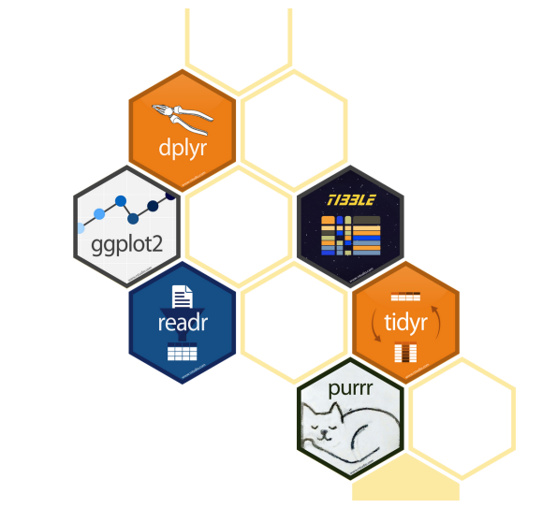
Using R
A very flexible way to implement econometric/quantitative methods!
“I am setting up R for the first time. Where, when, and with who we can seek extra help outside of class, if needed?”

Slide 18
Using R
A very flexible way to implement econometric/quantitative methods!
“I am setting up R for the first time. Where, when, and with who we can seek extra help outside of class, if needed?”
Make sure R is installed and setup (with Copilot!)
Assignment 0 (we will spend time going over some of this this/next time)
HAD5772 makes a great foundational course!
Notes:
We can’t cover everything in one course, so we will need to assume a common starting point. The review of Assignment 0 will be *very* brief, if you have specific questions, please send them my way! If you are feeling like you are lagging, there is a course for you! Also, rely on your groups and Copilot

Slide 19
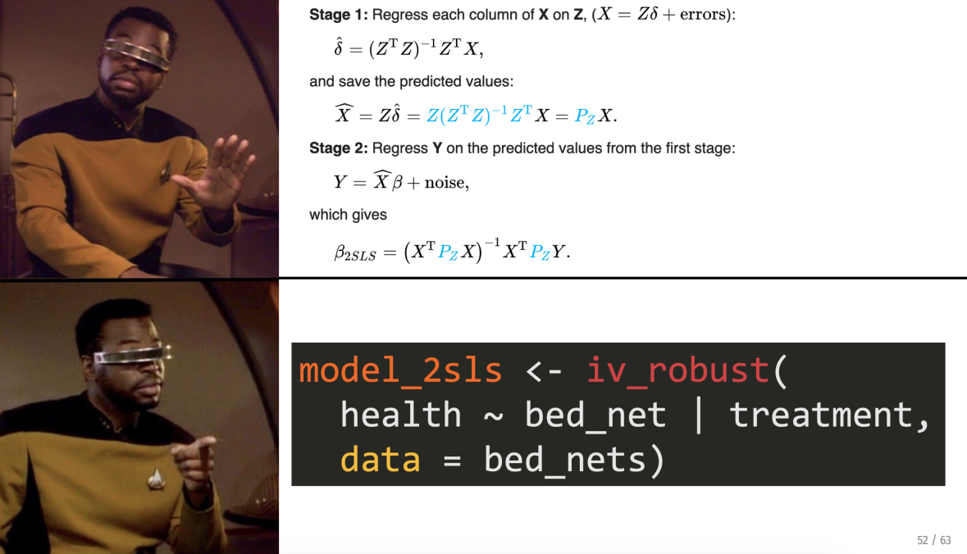
Using R
We will use the tidyverse
Makes R code read more like English!
We will emphasize practical applications (e.g., coding) over theory
Notes:
Note: there will still be some theory, but less

Slide 20
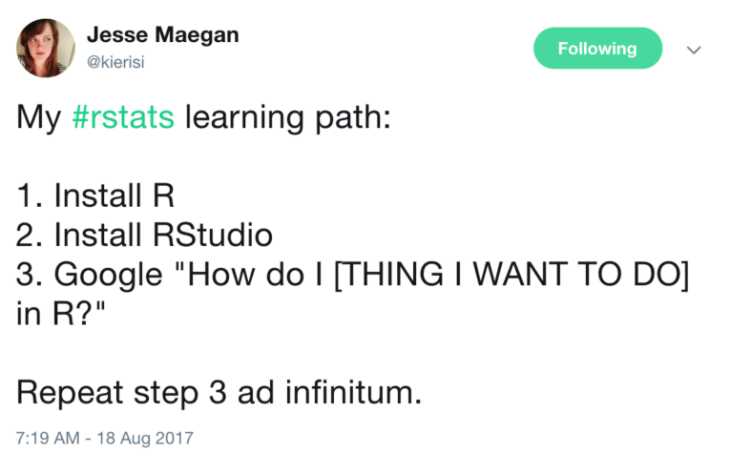
Using R: A Trial of Patience/Faith/Etc.
Mini-modules: https://jacobjameson.github.io/Intro%20R.html
Notes:
It can be a pain to learn R – but the best way to learn really is trial by error. Note that there’s some literature/ideas out there that it’s good to suck at something (it’s the first step to being good at something), but I don’t want you to feel like you are sucking! Come to me with questions, but don’t be stressed if you are feeling frustrated. These are tools that will serve you well, invest in them (copilot is a great resource!)

Slide 21

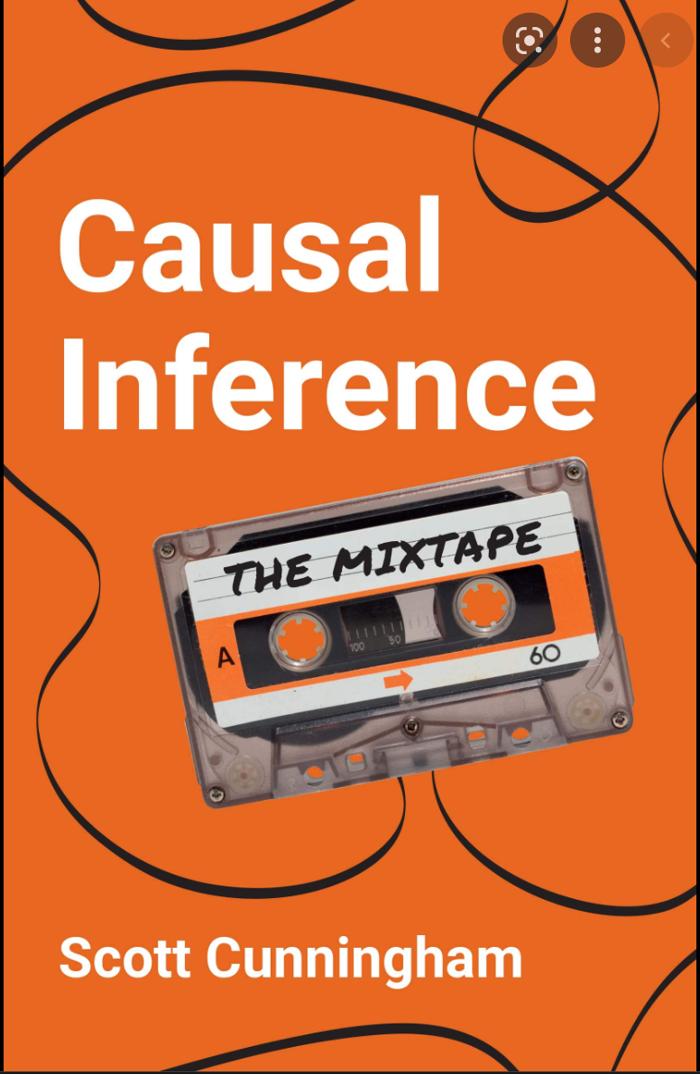
Introduction & Syllabus
Notes:
Cheap, great resource, online version available. Highly recommend for all applied quant researchers.

Slide 22
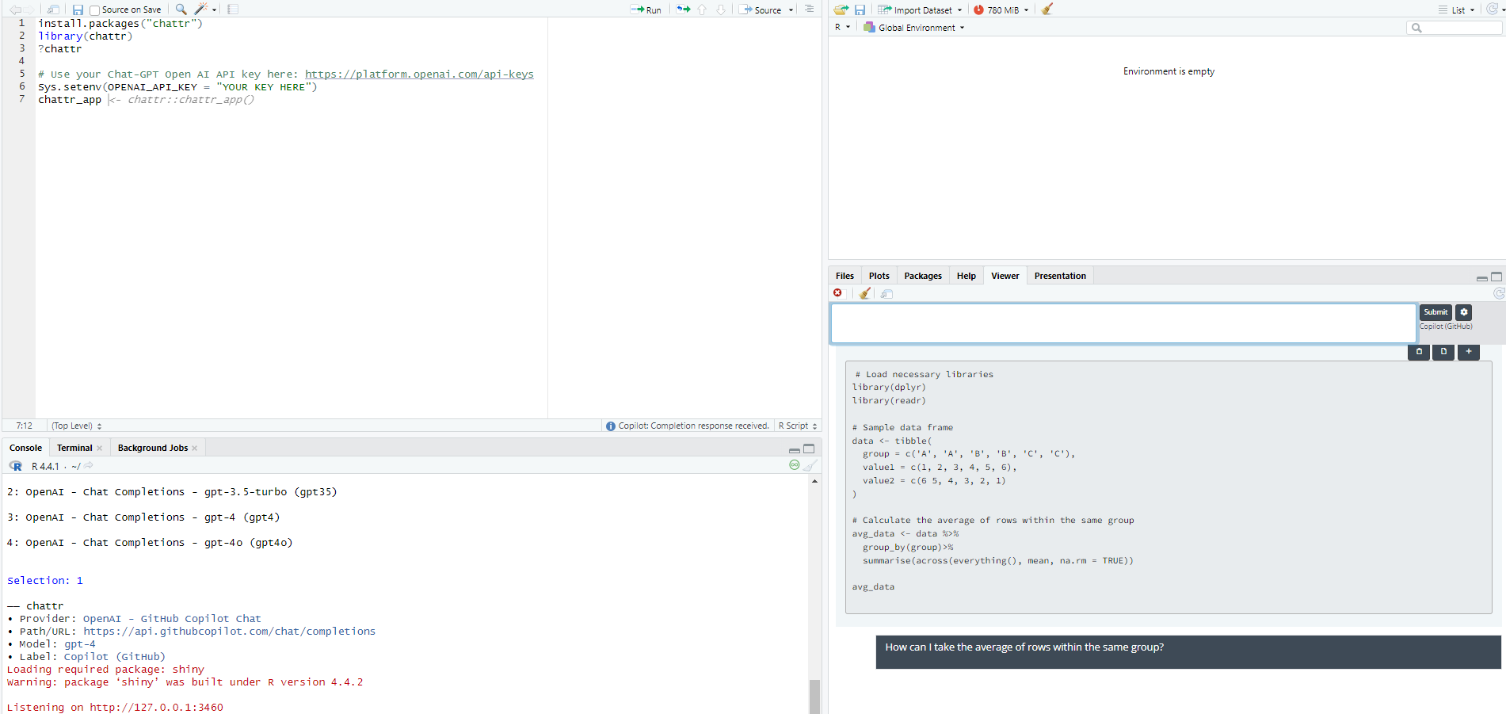
What about Chat-GPT?
Course policy on generative AI: use it carefully, take responsibility for your work (and learning), and do not plagiarize
Generative AI has strengths and weaknesses in quant research
Notes:
Note: chat GPT makes this worse for everyone if it’s misused. Way too much output obfuscating your own learning and my own ability to give you feedback. We’re trying some new things this semester to try to get around this.
One thing it’s good at (ish) – coding! Here is how you can integrate with R Studio and ask questions. Remember that the more detailed the question, the better the answer. (Note that this will only give you coding help, but there’s a reason you should do it this way – it will see your code and history!)

Slide 23
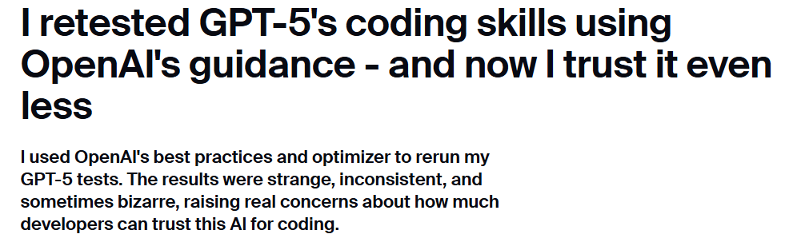
What about Chat-GPT?
Course policy on generative AI: use it carefully, take responsibility for your work (and learning), and do not plagiarize
Generative AI has strengths and weaknesses in quant research
Case study: here.
Notes:
It’s *much* more variable at interpreting statistics. For example, this is good – although erring on the side of too much information. A worse outcome is this one: https://chatgpt.com/share/677d4e1b-46f0-8000-9cd8-e09f628f7795.
Not really engaging in the context discussion
Missing some obvious things (yes, a doubling of head trauma rates is serious)
Provides too much information – you risk losing points for going on tangents that aren’t related to the question
Ultimately, you take your learning into your hands. How could you use this in an assignment?
If I feel it’s plagiarized, then it’s plagiarized. Will also be using Pangram as a resource here.
Is this clickbait? Probably. But still has a point.

Slide 24
Course Outline
Foundations
Regression in Practice (Associations)
Research Design
Causal Inference Methods
Optional topics
Synthetic Controls
Machine Learning for Quant Research (Causality)
Matching
Instrumental Variables
Nonlinear regression models
Difference-in-differences
Notes:
Lets talk about our methodological toolkit – whether its social epidemiology, health economics, biostats, etc., this has evolved significantly over time. Early approaches relied on basic regression models to identify associations between social factors and health, often in cross-sectional designs. Researchers then incorporated longitudinal and multilevel approaches to capture dynamic and contextual influences on health (this is next semester). The focus then shifted to understanding mechanisms through mediation analysis and causal inference techniques, while econometric and quasi-experimental methods enhanced our ability to assess policy impacts. More recently, AI and machine learning have entered the field, offering new analytical opportunities but also raising challenges related to bias and interpretability. See here for more: https://leongcentre.utoronto.ca/social-epidemiology-course
We will have case studies for each of these, starting next week. **Case studies try hard to cover a lot of disciplines and different healthcare settings (Canada, US, developing countries)** If you have specific interests, let me know.

Slide 25
Course Outline: Assignments
Foundations
Regression in Practice (Associations)
Research Design
Causal Inference Methods
Optional topics
Synthetic Controls
Machine Learning for Quant Research (Causality)
Matching
Instrumental Variables
Nonlinear regression models
Difference-in-differences
Assignment 1: foundations and data work
Assignment 2: applied regression
Assignment 3: Matching/IV
Assignment 4: Nonlinear/DD
Notes:
In addition to assignments (application), we will also have case studies (interpretation) for each lecture. Go over case study for next week, talk about expectations here.

Slide 26
Course Outline: Major papers
Foundations
Regression in Practice (Associations)
Research Design
Causal Inference Methods
Optional topics
Synthetic Controls
Machine Learning for Quant Research (Causality)
Matching
Instrumental Variables
Nonlinear regression models
Difference-in-differences
Goals:
Identify teams and research question (due Oct 27)
Find data sources
Start data cleaning
Goals:
Identify research design
Advance reading
Data cleaning and preliminary analysis
Outline due Nov. 10
Goals:
Finalize analysis
Writeups
Paper + Presentations in December
Notes:
Lets talk about our methodological toolkit – whether its social epidemiology, health economics, biostats, etc., this has evolved significantly over time. Early approaches relied on basic regression models to identify associations between social factors and health, often in cross-sectional designs. Researchers then incorporated longitudinal and multilevel approaches to capture dynamic and contextual influences on health (this is next semester). The focus then shifted to understanding mechanisms through mediation analysis and causal inference techniques, while econometric and quasi-experimental methods enhanced our ability to assess policy impacts. More recently, AI and machine learning have entered the field, offering new analytical opportunities but also raising challenges related to bias and interpretability. See here for more: https://leongcentre.utoronto.ca/social-epidemiology-course

Slide 27
Quantitative Frameworks

Slide 28
What are we aiming to do?
Associations: What are the relationships between variables?
Key question: what do associations actually capture? What can we describe with just our data?
Notes:
Our goal is to understand a DGP – what gives rise to the data we see in the world? Example: being sick and going to the doctor. Another example: what is the impact of a particular policy (such as fitness exam for children)

Slide 29
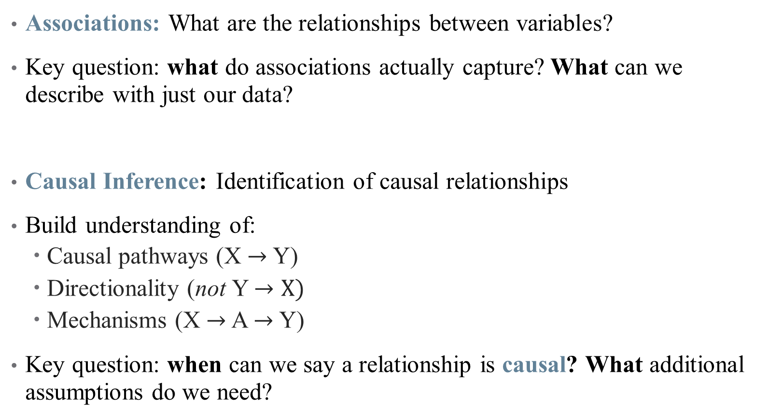
What are we aiming to do?
Associations: What are the relationships between variables?
Key question: what do associations actually capture? What can we describe with just our data?
Causal Inference: Identification of causal relationships
Build understanding of:
Causal pathways (X $→$ Y)
Directionality (not Y $→X)$
Mechanisms (X $→$ A $→$ Y)
Key question: when can we say a relationship is causal? What additional assumptions do we need?
Notes:
Our goal is to understand a DGP – what gives rise to the data we see in the world? Example: being sick and going to the doctor.
Historically, some fields (economics) have prioritized causal questions over and above associations and descriptive work. Others use largely correlations/associations. Why might we care more about causal work? What about associations might still be important? [Discussion]

Slide 30
All that glitters is an RCT?
Can we only believe randomized control trials?
Notes:
Gol standard of med research is RCT – is that all we can use? Example: effectiveness of a drug

Slide 31
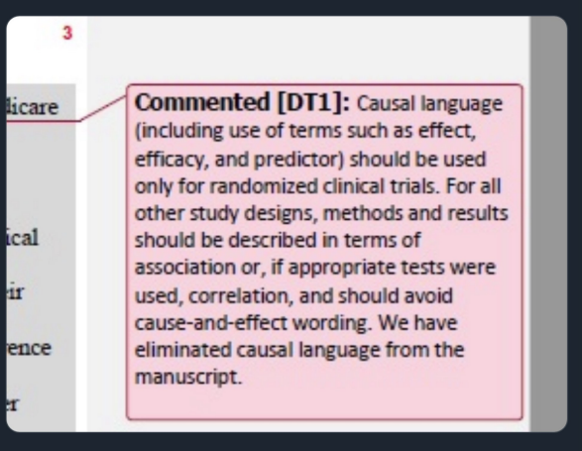
All that glitters is an RCT?
Can we only believe randomized control trials?
Notes:
But gold standard has been taken over by medical journals in particular. (although this is changing!)

Slide 32
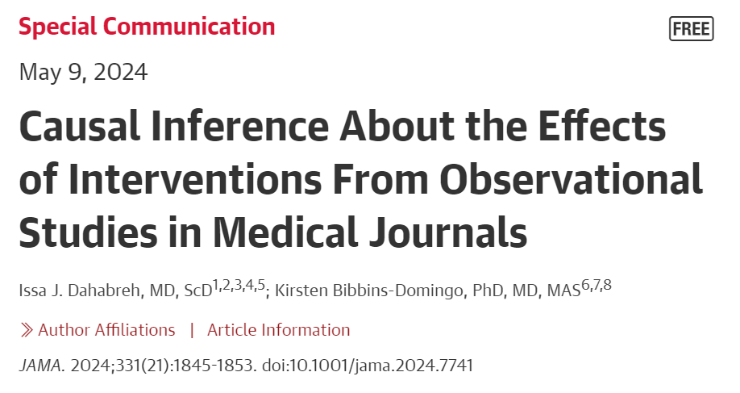
All that glitters is an RCT?
Can we only believe randomized control trials?
Notes:
But gold standard has been taken over by medical journals in particular. (although this is changing!)

Slide 33
All that glitters is an RCT?
Can we only believe randomized control trials?
RCTs are useful in some settings, but what are some problems with them?
Notes:
Gol standard of med research is RCT – is that all we can use?

Slide 34
All that glitters is an RCT?
Can we only believe randomized control trials?
RCTs are useful in some settings, but what are some problems with them?
Not always feasible
Implicit biases
Can’t always detect negative side effects
Problems with external validity, scaling, etc.
Econometric analysis helps identify real world patterns from real world data
Notes:
Decades of research goes into understanding how real data can give us (some) real answers. There are more assumptions and some limits on the parameters you return, but that’s a tradeoff worth taking.

Slide 35
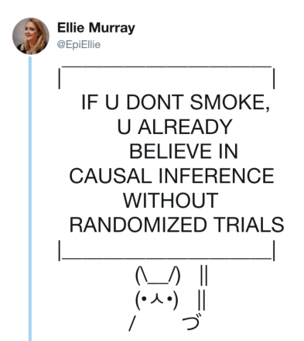
All that glitters is an RCT?
Notes:
Policies are not all based on RCTs -- many rely on real-world data and causal inference. The questions are: (1) is that causal inference sound? And (2) more philosophically – to what extent should all policy be built on evidence vs. art/craft/intuition? Do we need more evidence about drinking age, for example?

Slide 36
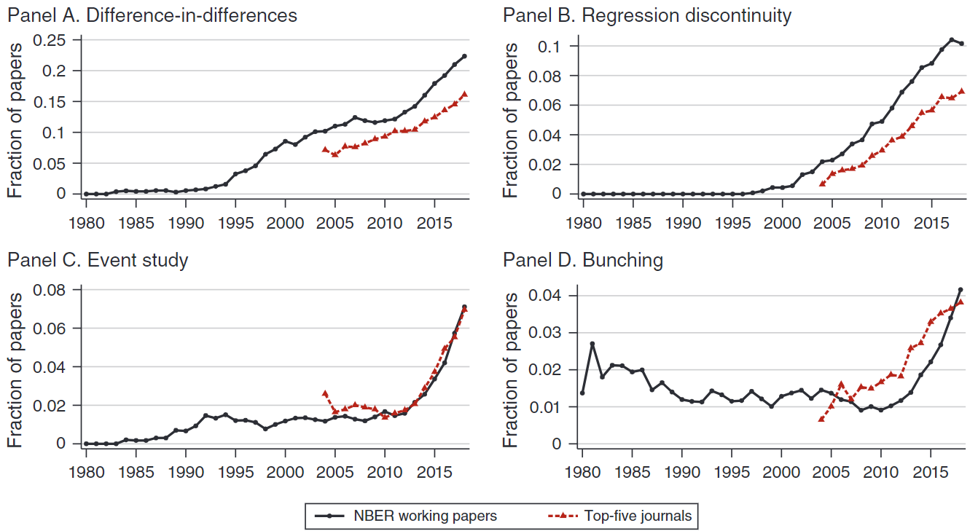
The rise of causal inference
Notes:
From Janet Currie, Henrik Kleven, and Esmee Zwiers (2020 AEA PP)

Slide 37
Econometric approach
Observational data: retrospective, “real-world” data
Not (typically) collected in a lab setting
Surveys, claims, tax records, etc.
What created that data?
Data Generating Process: what unique collection of characteristics, events, and randomness coalesced to form the data we are looking at?
Our objective is to use the data available to try and establish the nature of the true DGP.
But many different DGPs are possible, and many may yield very similar patterns!
Notes:
Example: Suppose we are making a diagnosis: How helpful is knowing a patient has a fever? Must consider all symptoms together → this requires us to build a *model*

Slide 38
What’s a model?
Goal: understand relation between:
Outcome (Y)
Treatment (D)
Covariate (X),
We must specify and test the mechanisms between these features
Why do we have to do this in detail?
Correlation is not causation (except when it is!)
Different variables may move in tandem without there being causal relations among them
https://www.tylervigen.com/spurious-correlations
Notes:
The helpful refrain of econometrics. We are going to talk today about 2 high-level ways to build models in quant research: DAGs (visual) and potential outcomes (precise measurement of policy effects)

Slide 39
DAGs
Notes:
We’re going to talk about two complementary frameworks today for thinking about moving from associations to causal frameworks: DAGs and PO. They have different strengths so its important to think about them both carefully.

Slide 40
A Ladder of Causality
Association
Correlations
Intervention
What would happen to $Y$ if I changed $X?$
What would happen to 𝑌 if I changed 𝑋?
Causality
Counterfactuals
Regression/ML predictions
What is the conditional distribution?
Randomized experiments, etc.
A lot of empirical HSR work happens here
Have to deal with identification threats
We chose to do $X,$but what if we had chosen $X^{′}?$
We chose to do 𝑋, but what if we had chosen 𝑋^′?
Harder to answer, requires even more structural assumptions
Mechanisms also (should?) go here
Notes:
Drawn in part from Guido Imbens’ JEP paper on research design and Judea Pearl’s book. We’re going to start with (1) next week and then move on to the rest.

Slide 41
DGPs as DAGs
Directed Acyclic Graphs (DAGs):
Graphical relationship of a chain of causal effects
Represented as random variables (nodes) and influencing events (arrows)
Maps a philosophical model
D
Y
X
Notes:
Note: there’s no math behind the causal structure – that’s all the hypothesis part of the scientific method. Once the structure is set, then you can do something with the math.
Immediate notes:
- There are no cycles (causality runs in one direction). So this model can’t handle reverse causality or simultaneous causality.

Slide 42

DGPs as DAGs
Directed Acyclic Graphs (DAGs):
Graphical relationship of a chain of causal effects
Represented as random variables (nodes) and influencing events (arrows)
Maps a philosophical model
Example: Physical Activity and Child Fitness
Question: Are school physical activity programs effective?
Y: Outcome of interest (student fitness, academic outcomes, etc.)
D: Treatment/program
X: Covariates – what might contribute to both D and Y?
D
Y
X
Notes:
May or may not be motivated by south of the border policy here, but this ha salso existed in Ontario for a long time! Ontario’s Daily Physical Activity (DPA) Policy
What it is: Since 2005, Ontario requires elementary schools to provide 20 minutes of sustained moderate-to-vigorous physical activity each school day.
Note: you might think D is exogenous (it’s a school policy). Let’s start with that and think about a simple way to measure the effectiveness of the policy.
Then: are there reasons D might not apply to everyone at the same level? How does this complicate a province-level analysis, or what else might we need here? (e.g., school fixed effects). This is our first introduction to exogeneity assumptions.

Slide 43
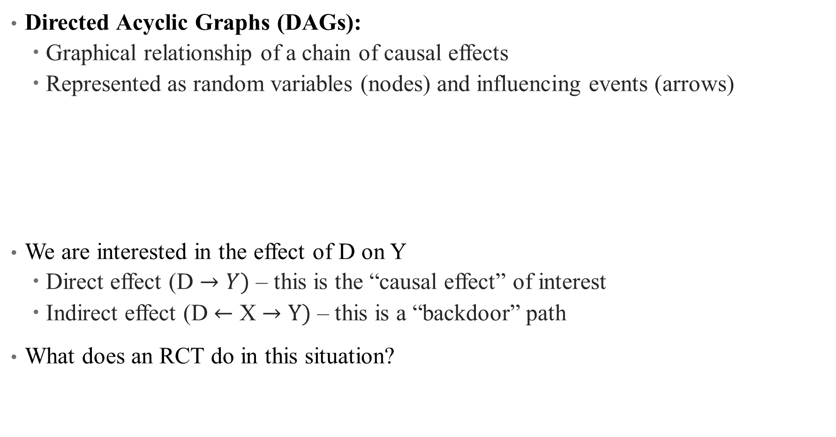
DGPs as DAGs
Directed Acyclic Graphs (DAGs):
Graphical relationship of a chain of causal effects
Represented as random variables (nodes) and influencing events (arrows)
We are interested in the effect of D on Y
Direct effect (D $→Y)$ – this is the “causal effect” of interest
Indirect effect (D $←$ X $→Y)$ – this is a “backdoor” path
What does an RCT do in this situation?
D
Y
X
Notes:
An RCT, in this situation, would eliminate (“close”) effect of X on Y by randomizing (so that there is no “X \rightarrow D”).
Types of relationships: (1) chain X -> y -> z; (2) fork z <- x -> y; (3) inverted fork / collider z -> x <- y (x is the collider; controlling for it can cause a spurious relationship between any of the three variables).
A DAG is distinctive in that the model should show the complete causal pathway and is also completely committed to the lack of causal pathways where there are no arrows. If it’s on the board, it doesn’t matter!

Slide 44
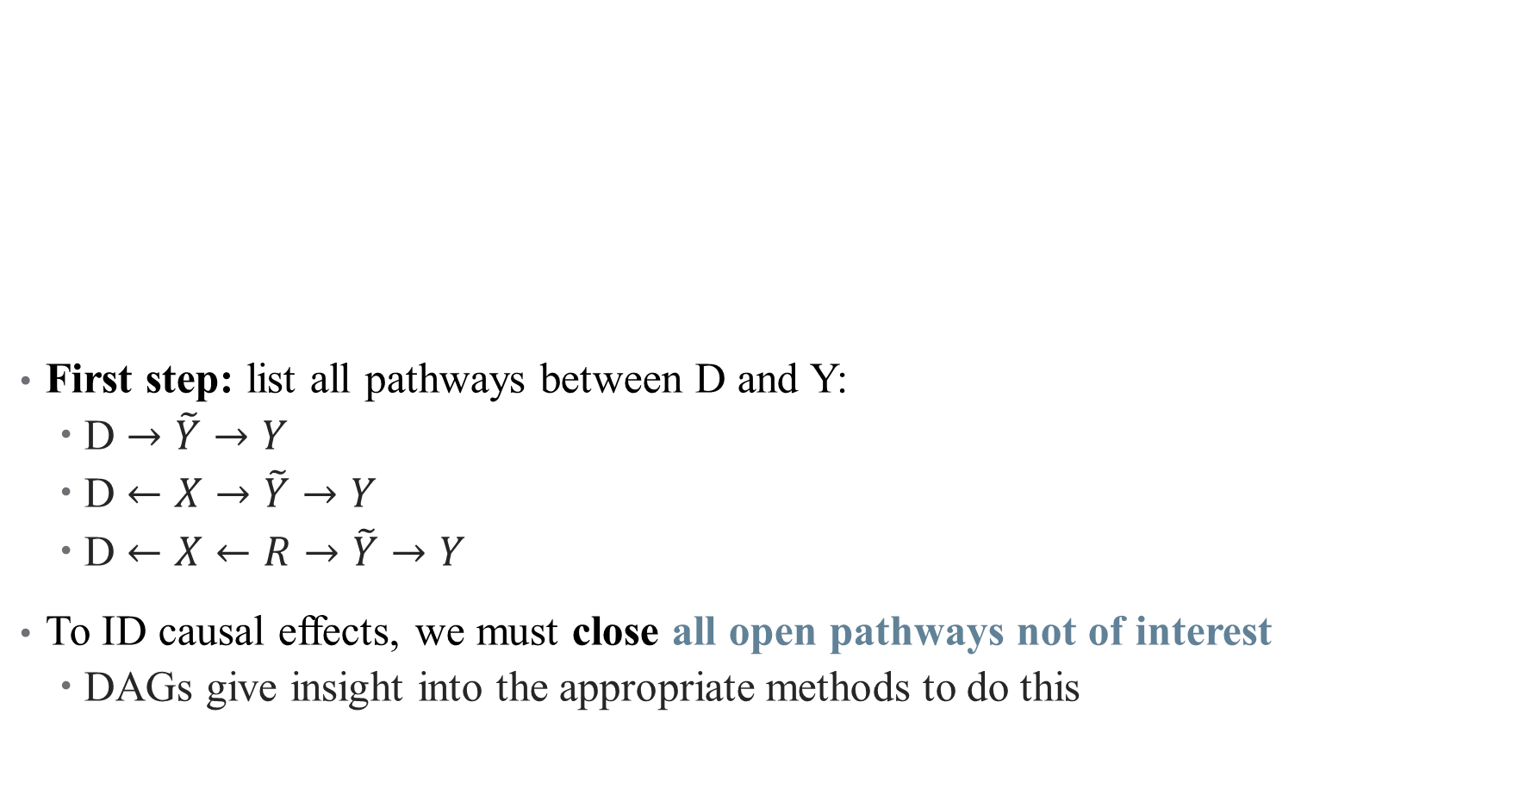

How do we define a causal relationship?
First step: list all pathways between D and Y:
D $→\tilde{Y}→Y$
D $←X→\tilde{Y}→Y$
D $←X←R→\tilde{Y}→Y$
To ID causal effects, we must close all open pathways not of interest
DAGs give insight into the appropriate methods to do this
X
D
$$\tilde{Y}$$
Y
B
Notes:
Let’s limit this a bit just so we can see what we could do. Suppose we highlighted the clearest “identification threats”.
- Note: we may also have unobserved variables capturing background information, shown here as B with the dashed lines (even more complexity!) what kinds of unobserved things might we have? Kids’ health on the day of the exam, blood sugar?
We may also have context validity problems – what are we trying to measure, and what do we actually measure? How well are those correlated?
Notice what’s not happening here. B has no influence on D; what is that saying? Is this believable? Why or why not?
A causal pathway is identified if the association between treatment and outcome is properly stripped and isolated. DAG methods (and do calculus) give insight into exactly what to do to isolate a pathway.

Slide 45
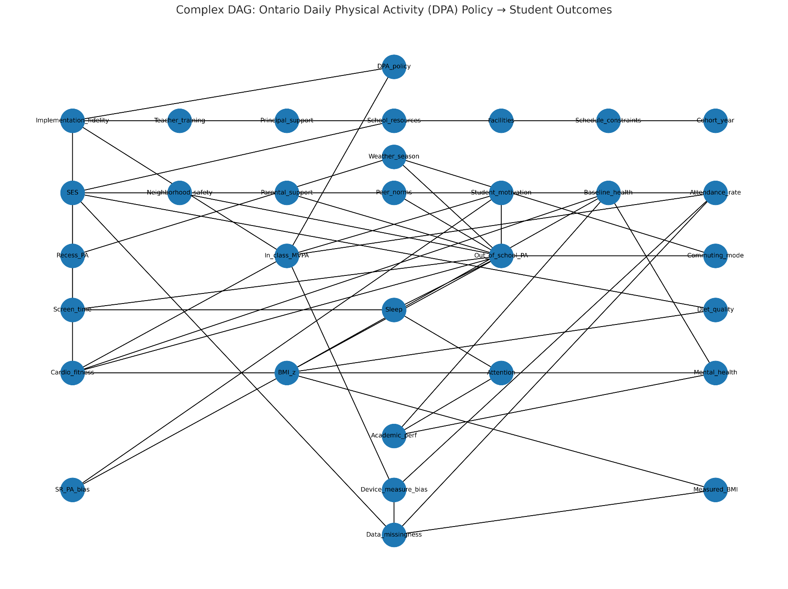
A More Involved DAG
X
D
$$\tilde{Y}$$
Y
R
Notes:
So how much is too much? This is a critical discussion of research design. This is also a key drawback currently of Chat GPT.

Slide 46
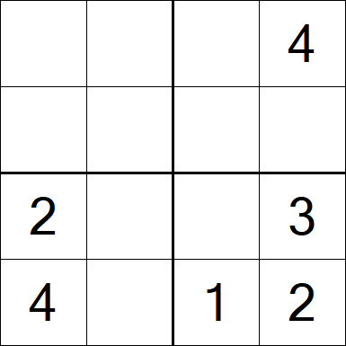
Introduction to Identification
The main problem here is one of identification: what is the story the data are telling?
Imagine a Sudoku puzzle. Identification is *knowing* what numbers go where. But not all squares are immediately identified!
Notes:
For example, the bottom right square is obviously almost complete. On the other hand, take the top left is almost completely unidentified at the moment. It’s not until all the pieces are filled in that we will identify that square. You start with the 4 in the (2,2) spot and then move from there. Importantly, not all sudoku puzzles are identified/well-posed! Same with our data.

Slide 47
Introduction to Identification
The main problem here is one of identification: what is the story the data are telling?
Imagine a Sudoku puzzle. Identification is *knowing* what numbers go where. But not all squares are immediately identified!
Using observational data to make causal claims means that we aren’t always guaranteed to be able to solve the puzzle. We need to make different assumptions to “identify” the effects of interest, and sometimes remaining issues threaten that identification.
Notes:
Let’s limit this a bit just so we can see what we could do. Suppose we highlighted the clearest “identification threats”.
- Note: we may also have unobserved variables, shown here with the dashed lines (even more complextity!) what kinds of unobserved things might we have? Kids’ health on the day of the exam, blood sugar?
A causal pathway is identified if the association between treatment and outcome is propertly stripped and isolated. DAG methods (and do calculus) give insight into exactly what to do to isolate a pathyway.

Slide 48
Let’s take the Con out of Econometrics (Edward Leamer, 1983)
“Econometricians would like to project the image of agricultural experimenters who divide a farm into a set of smaller plots of land and who select randomly the level of fertilizer to be used on each plot. If some plots are assigned a certain amount of fertilizer while others are assigned none, then the difference between the mean yield of the fertilized plots and the mean yield of the unfertilized plots isa measure of the effect of fertilizer on agricultural yields. The econometrician's humble job is only to determine if that difference is large enough to suggest a real effect of fertilizer, or is so small that it is more likely due to random variation.
“I would like to suggest a more accurate [image]. The applied econometrician is like a farmer who notices that the yield is somewhat higher under trees where birds roost, and he uses this as evidence that bird droppings increase yields. However, when he presents this finding at the annual meeting of the American Ecological Association, another farmer in the audience objects that he used the same data but came up with the conclusion that moderate amounts of shade increase yields. A bright chap in the back of the room then observes that these two hypotheses are indistinguishable, given the available data. He mentions the phrase "identification problem," which, though no one knows quite what he means, is said with such authority that it is totally convincing.”
Notes:
This is from a more standard economics paper, but the idea here applies to all quant fields attempting to deal with causal questions. This is the best image of what we’re trying to do here. Why is this an identification threat?

Slide 49
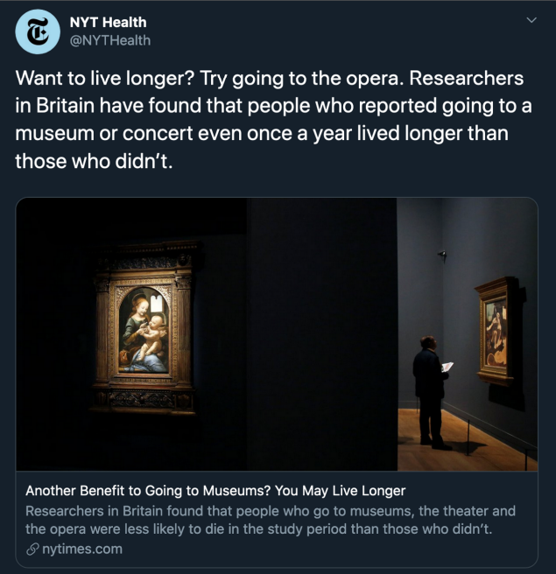
Why do we need DAGs?
Notes:
What would we say to this headline? Easy to just say correlation doesn’t imply causation – except that it *can*, so this isn’t enough of a response (and it kills conversation). Instead, we want to know *why* this result isn’t good enough to say it’s causal.

Slide 50
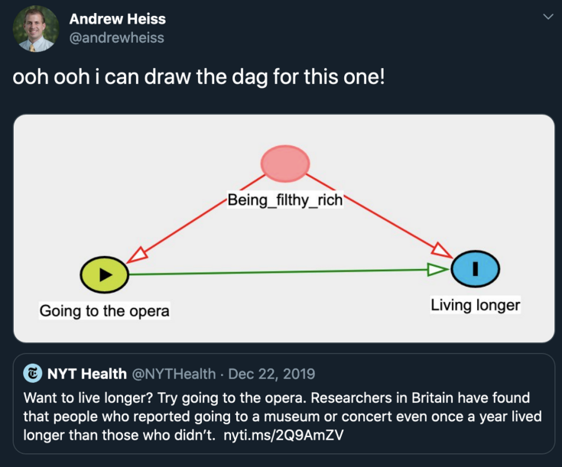
Why do we need DAGs?
Notes:
Instead, we want to know *why* this result isn’t good enough to say it’s causal.

Slide 51
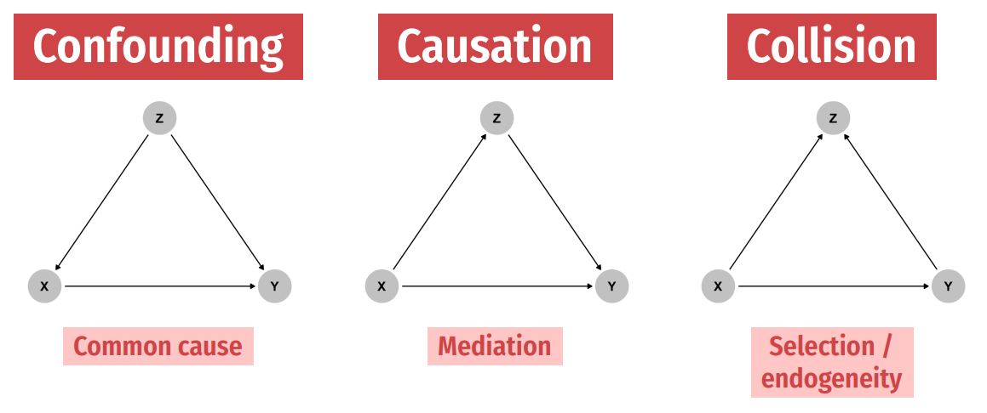
Associations in DAGs
Notes:
DAGs give names and structures to types of obstacles to causal inference. Examples: confounding was just done. Can you think of others? (Mediation is like effect of education on salary, by race; collision is like admission rate bias – you might discover spurious correlations between diseases if you have a selected sample of hospitalized patients, such as between respiratory disease and locomotor disease) We’ll talk about these all more in class.

Slide 52
Associations in DAGs
Notes:
Note: Mediation is a *directed path* where the arrows all point in the same direction. (Mediation is like effect of education on salary, by race; collision is like admission rate bias – you might discover spurious correlations between diseases if you have a selected sample of hospitalized patients, such as between respiratory disease and locomotor disease) We’ll talk about these all more in class.

Slide 53
Associations in DAGs
Notes:
Here, note the direction of the arrows has changed. The treatment (X) and the causal effects of X on Y collide at Z. A collider, on its own, actually closes the backdoor path – there isn’t an open backdoor from X to Y here because of the arrow directions. So actually, you don’t want to control for Z here, and if you do, you can introduce bias!
An example: (there are some other really good ones in SC’s book!) trying to uncover gender-based discrimination in the workplace.

Slide 54
Some Drawbacks of DAGs
DAGs are very clear and allow you to state identification assumptions. However:
Causality runs in one direction (simultaneity and reverse causality usually better represented with potential outcomes framework)
Where does the DAG come from? This is the question
What about estimation and inference? What’s a collider and what’s a confounder?
For help drawing DAGs in R, see https://evalf22.classes.andrewheiss.com/example/dags.html
X
D
$$\tilde{Y}$$
Y
R
Notes:
DAG is a theoretical, hypothesized object. If you tell me how the world works (the DAG) then I can tell you exactly how to “identify” the causal parameter (note: that doesn’t mean I’ll tell you how to estimate it or conduct inference on it). But you have to believe me that the DAG is important (and you can see in our earlier exercise why that isn’t necessarily straightforward).

Slide 55
Potential Outcomes
Notes:
We’re going to talk about two complementary frameworks today for thinking about moving from associations to causal frameworks: DAGs and PO. They have different strengths so its important to think about them both carefully.

Slide 56
Another approach: Potential Outcomes
Central idea: causal effects are drawn from randomization
Causal effects are defined as comparison between two states of the world: the actual world and a counterfactual
Example: what is the causal effect of taking aspirin for a headache? What would my physical fitness level be if I didn’t have to take the Presidential Fitness Test?
Remember: can we approximate an experiment using observational data?
Notes:
So the DAG was useful for one set of reasons, but ultimately has flaws that can’t quite be overcome (reverse causality, where does the DAG come from, all kinds of selection, unobservable data, inference and estimation). The PO framework says – what if can get around all of that by literally examining the same person in two different worlds?

Slide 57
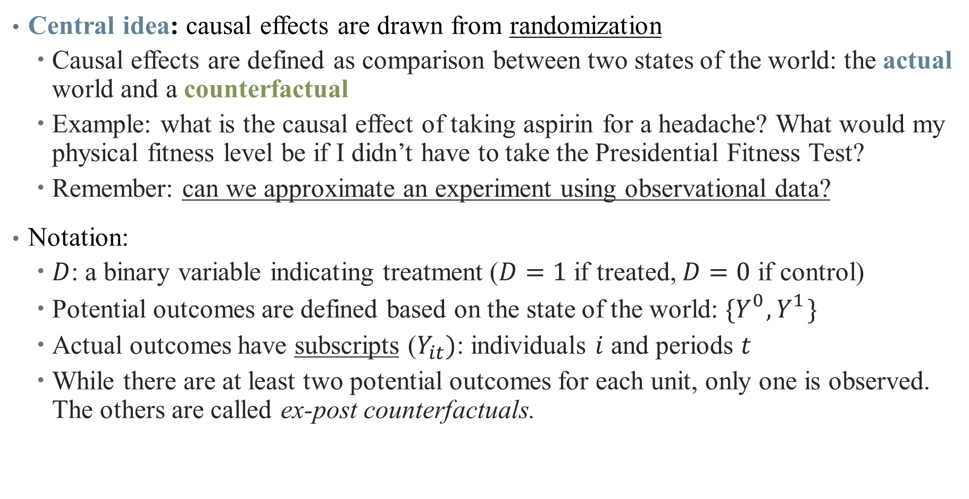
Another approach: Potential Outcomes
Central idea: causal effects are drawn from randomization
Causal effects are defined as comparison between two states of the world: the actual world and a counterfactual
Example: what is the causal effect of taking aspirin for a headache? What would my physical fitness level be if I didn’t have to take the Presidential Fitness Test?
Remember: can we approximate an experiment using observational data?
Notation:
$D$: a binary variable indicating treatment ($D=1$ if treated, $D=0$ if control)
Potential outcomes are defined based on the state of the world: ${\{Y}_{}^{0},Y_{}^{1}\}$
Actual outcomes have subscripts ($Y_{it})$: individuals $i$ and periods $t$
While there are at least two potential outcomes for each unit, only one is observed. The others are called ex-post counterfactuals.
Notes:
Superscripts versus subscripts. Here we are going to leverage variation that isn’t in our control as a researcher to approximate that experiment (construct a treatment group and a control group, in the simplest case)

Slide 58
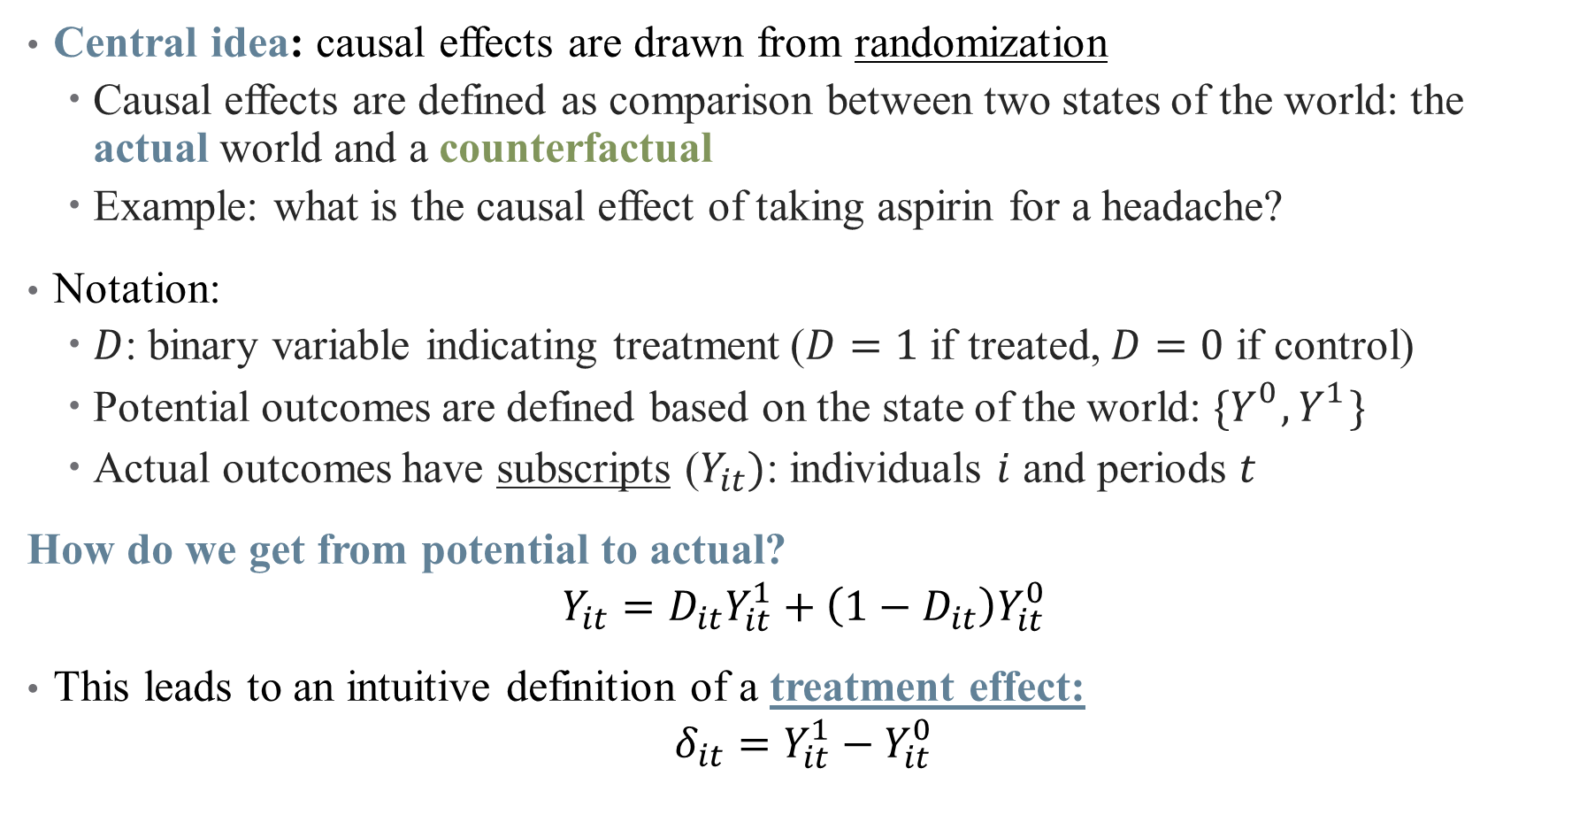
Another approach: Potential Outcomes
Central idea: causal effects are drawn from randomization
Causal effects are defined as comparison between two states of the world: the actual world and a counterfactual
Example: what is the causal effect of taking aspirin for a headache?
Notation:
$D$: binary variable indicating treatment ($D=1$ if treated, $D=0$ if control)
Potential outcomes are defined based on the state of the world: ${\{Y}_{}^{0},Y_{}^{1}\}$
Actual outcomes have subscripts ($Y_{it})$: individuals $i$ and periods $t$
How do we get from potential to actual?
$$Y_{it}=D_{it}Y_{it}^{1}+\left(1−D_{it}\right)Y_{it}^{0}$$
This leads to an intuitive definition of a treatment effect:
$$δ_{it}=Y_{it}^{1}−Y_{it}^{0}$$
Notes:
What’s the central problem here? For each individual, we only observe 1 or the other! This is the fundamental problem of causal inference

Slide 59
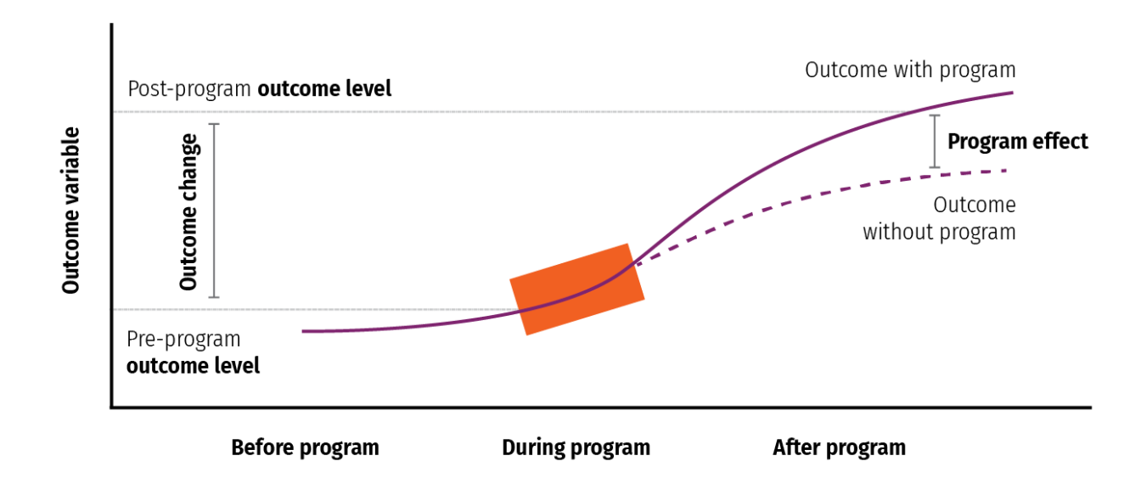
Another approach: Potential Outcomes
Notes:
If we observed both outcomes for an individual, calculating the ATE (parameter of interest) would be easy (like in It’s a Wonderful Life). Since we can’t do that, what we do instead is ensure that we observe multiple units so that we can see units receiving each of the various treatments. We then must assume something about the assignment *mechanism* that determines which units receive treatments to say something about the ATE.

Slide 60
Natural Experiments
What does a natural experiment entail? How does it match this framework?
Perhaps the first natural experiment in medicine was that of the English physician John Snow.
In 1854, a cholera outbreak struck Broad Street in London, killing hundreds.
Snow discovered that neighborhoods supplied with water downstream of where sewage was discharged into the Thames River experienced high levels of disease, while neighborhoods receiving upstream water had low disease levels.
What evidence did Snow use to make this causal?
Notes:
From our case study: what things are important here? Similar populations, so that the “division into treatment/control groups was without choice”

Slide 61
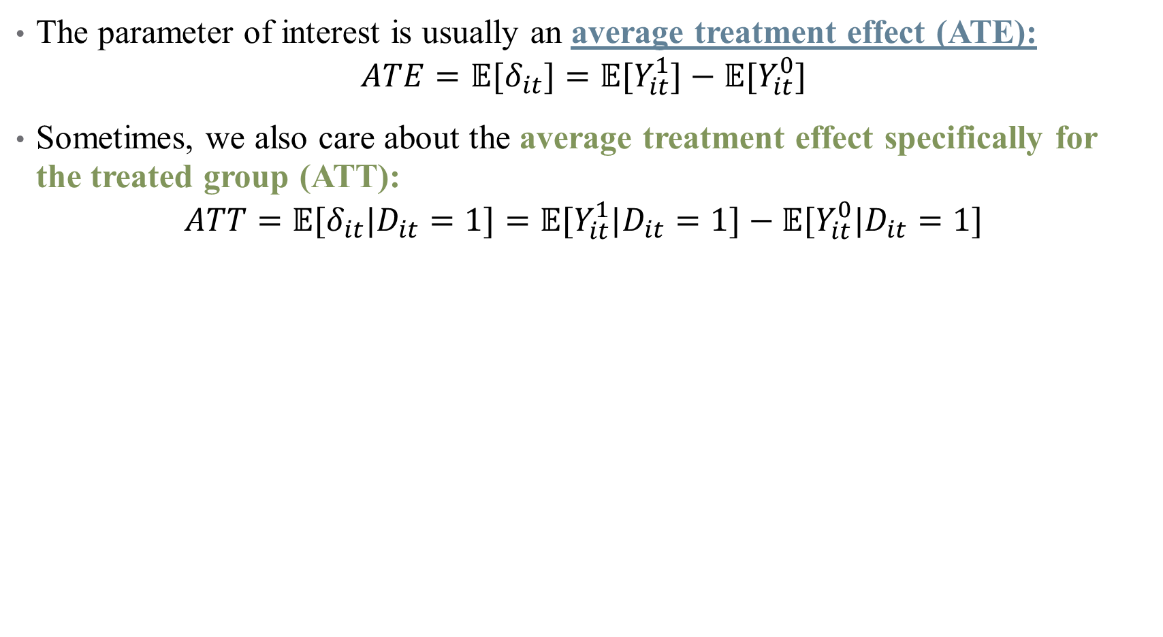
Average Treatment Effects
The parameter of interest is usually an average treatment effect (ATE):
$$ATE=𝔼[δ_{it}]=𝔼[Y_{it}^{1}]−{𝔼[Y}_{it}^{0}]$$
Sometimes, we also care about the average treatment effect specifically for the treated group (ATT):
$$ATT=𝔼[δ_{it}|D_{it}=1]=𝔼[Y_{it}^{1}|D_{it}=1]−{𝔼[Y}_{it}^{0}|D_{it}=1]$$
Notes:
To get around our problem of only observing one state per individual, we use averages. Expectations will be covered more next lecture – here we’re thinking averages of observed data.
How does this relate to the case study above? What are the averages here? What assumptions do we need for this to be a treatment effect? (Balance)

Slide 62
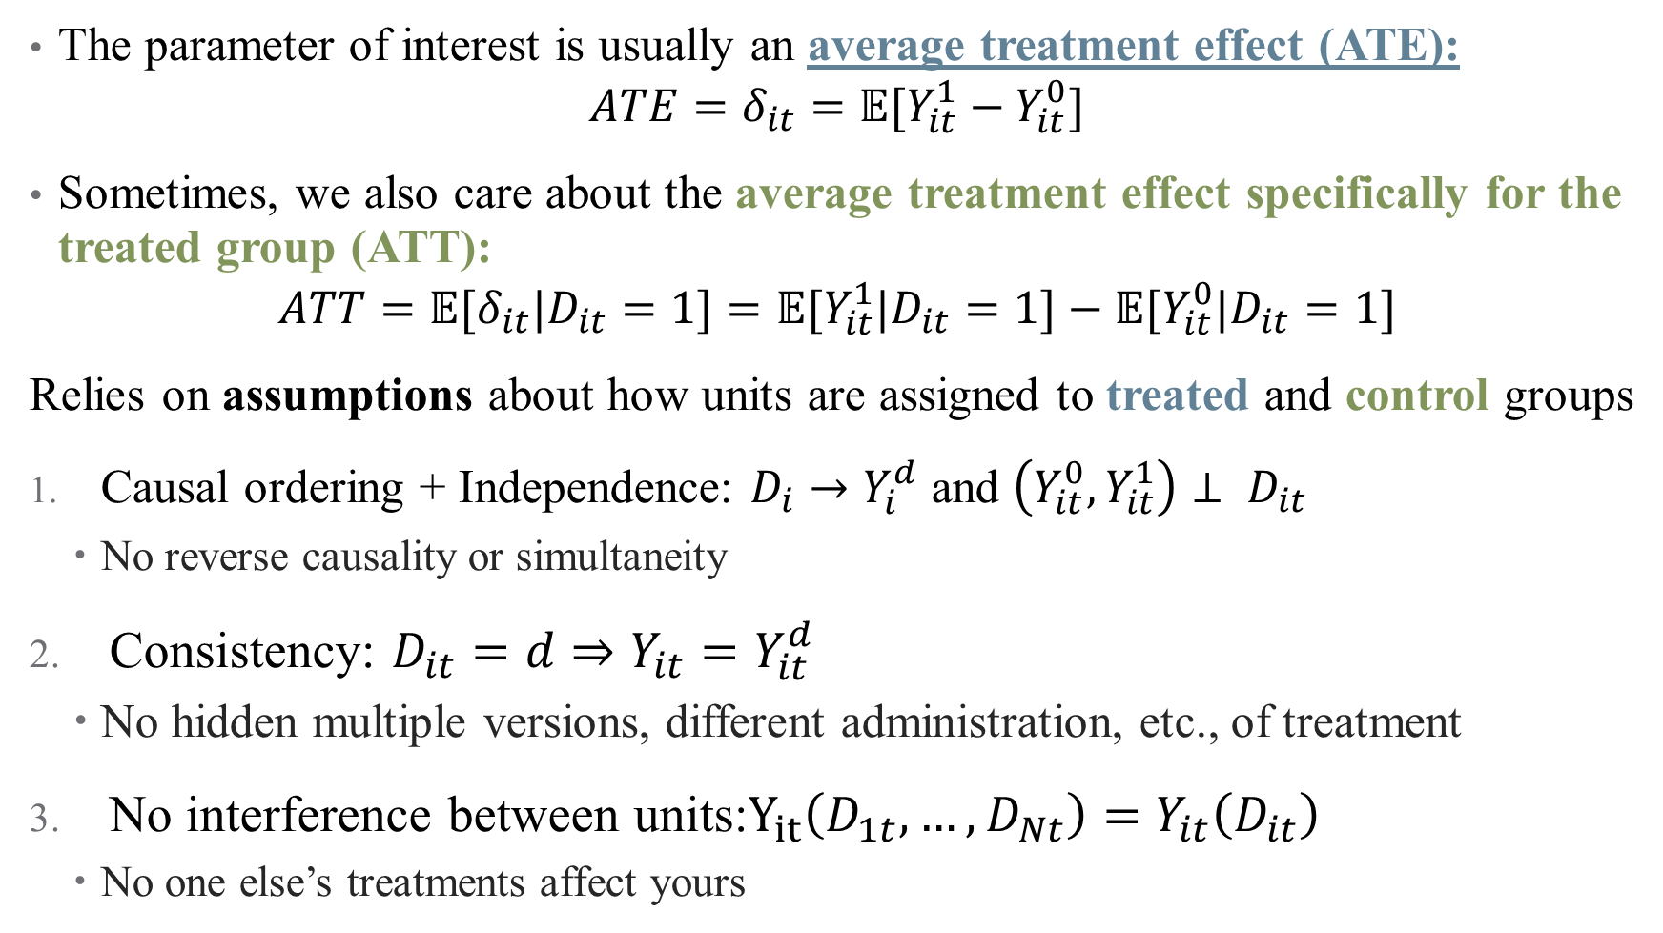
Average Treatment Effects
The parameter of interest is usually an average treatment effect (ATE):
$$ATE=δ_{it}=𝔼[Y_{it}^{1}−Y_{it}^{0}]$$
Sometimes, we also care about the average treatment effect specifically for the treated group (ATT):
$$ATT=𝔼[δ_{it}|D_{it}=1]=𝔼[Y_{it}^{1}|D_{it}=1]−{𝔼[Y}_{it}^{0}|D_{it}=1]$$
Relies on assumptions about how units are assigned to treated and control groups
Causal ordering + Independence: $D_{i}→Y_{i}^{d}$ and $\left(Y_{it}^{0},Y_{it}^{1}\right)⊥ D_{it}$
No reverse causality or simultaneity
Consistency: $D_{it}=d⇒Y_{it}=Y_{it}^{d}$
No hidden multiple versions, different administration, etc., of treatment
No interference between units:$Y_{it}\left(D_{1t},…, D_{Nt}\right)=Y_{it}\left(D_{it}\right)$
No one else’s treatments affect yours
Notes:
We’ll discuss assumptions in more detail in next lecture (and throughout the course). Note that the two pieces of 1 are related (the second part says basically randomization of D). But this is often violated on its own! Think about taking medicine when you’re sick.
* Note that unconfoundedness is still weaker than purely random treatment assignment – it can depend on pretreatment variables in unknown ways, and we can still recover treatment effects provided all of that is *uncorrelated* with the outcome.

Slide 63
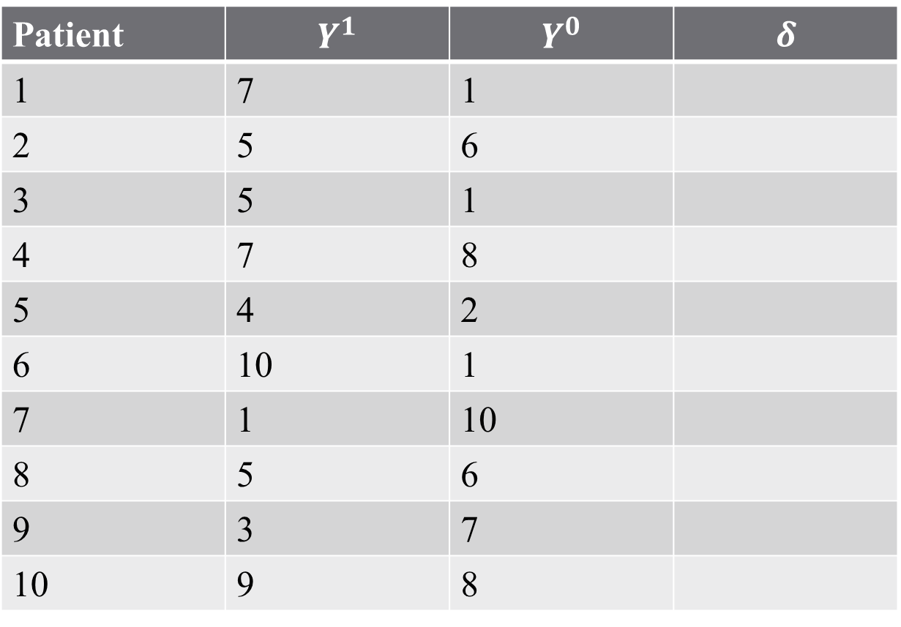
Example: Treatment Outcomes
How effective is a medical treatment?
Patient | $$Y^{1}$$ | $$Y^{0}$$ | $$δ$$
1 | 7 | 1
2 | 5 | 6
3 | 5 | 1
4 | 7 | 8
5 | 4 | 2
6 | 10 | 1
7 | 1 | 10
8 | 5 | 6
9 | 3 | 7
10 | 9 | 8
Notes:
Why do averages work? Let’s assume that we have some measure of health outcome (satisfaction, years of life, etc.) from a treatment Y1 and no treatment Y0. Suppose we have an oracle (not my word) that gives us both states of the world for all individuals.
What do the assumptions mean here?
We assume surgery affects outcome, not outcome affecting surgery. We also assume assignment to surgery has nothing to do with relative difference between outcomes across states of the world (no selection).
We assume we measure outcomes perfectly in each state, and know state assignments perfectly.
My surgery status doesn’t affect your outcomes (seems okay at first glance, but why might this be violated in practice?)

Slide 64
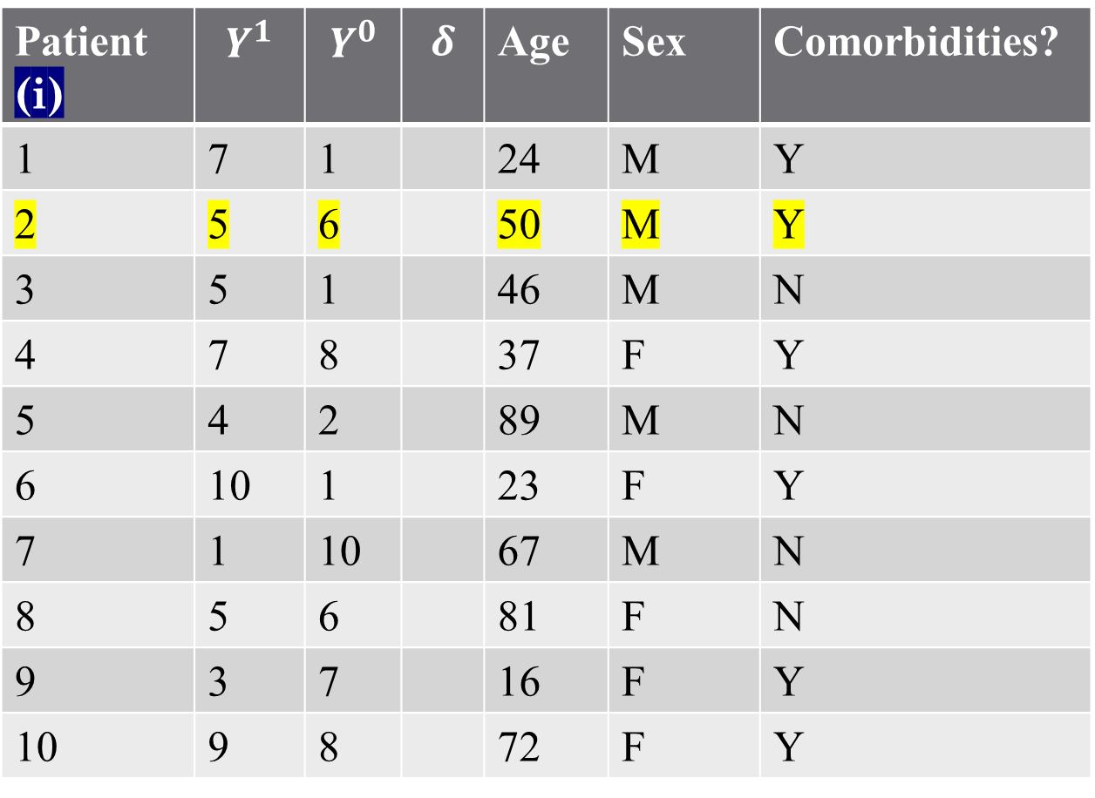
Example: Treatment Outcomes (sidenote: the structure of data)
Covariates
Patient (i) | $$Y^{1}$$ | $$Y^{0}$$ | $$δ$$ | Age | Sex | Comorbidities?
1 | 7 | 1 |  | 24 | M | Y
2 | 5 | 6 |  | 50 | M | Y
3 | 5 | 1 |  | 46 | M | N
4 | 7 | 8 |  | 37 | F | Y
5 | 4 | 2 |  | 89 | M | N
6 | 10 | 1 |  | 23 | F | Y
7 | 1 | 10 |  | 67 | M | N
8 | 5 | 6 |  | 81 | F | N
9 | 3 | 7 |  | 16 | F | Y
10 | 9 | 8 |  | 72 | F | Y
Observation
Notes:
Talk about each row / observation containing all relevant information. This is the structure you’ll need for regressions. This is a cross-sectional data set (one row per unit – in this case patient). A panel repeats the observation over time (more next semester).

Slide 65
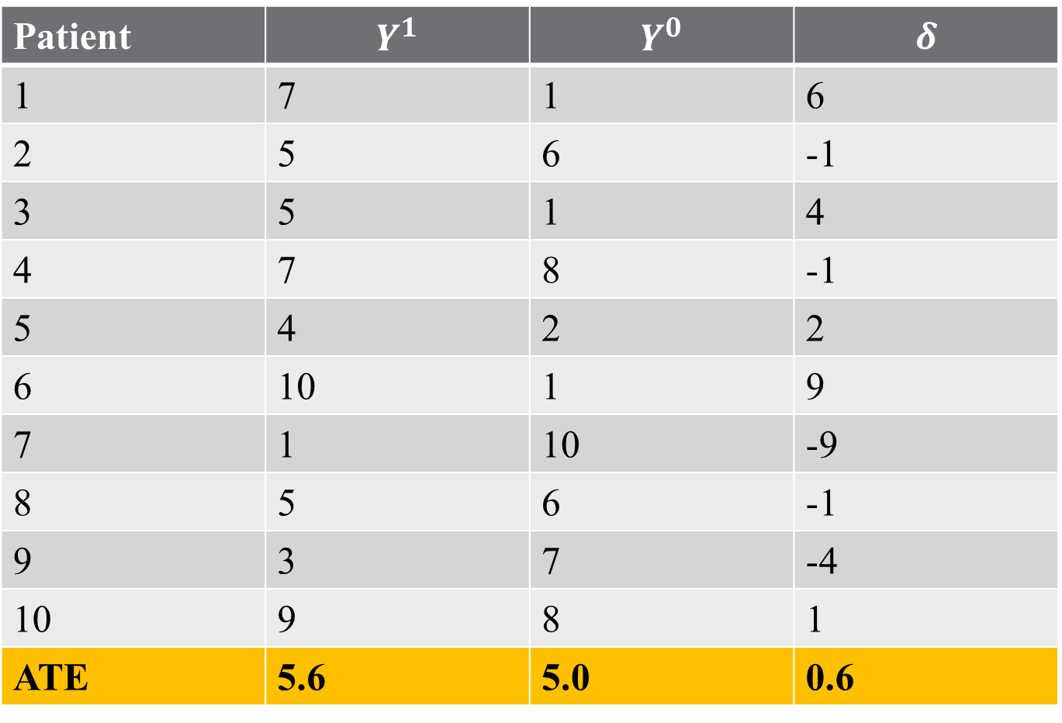
Example: Treatment Outcomes
How effective is a medical treatment?
Patient | $$Y^{1}$$ | $$Y^{0}$$ | $$δ$$
1 | 7 | 1 | 6
2 | 5 | 6 | -1
3 | 5 | 1 | 4
4 | 7 | 8 | -1
5 | 4 | 2 | 2
6 | 10 | 1 | 9
7 | 1 | 10 | -9
8 | 5 | 6 | -1
9 | 3 | 7 | -4
10 | 9 | 8 | 1
ATE | 5.6 | 5.0 | 0.6
Notes:
This would be the ATE for the population (assuming that there are only 10 people in this population). So on average, is the treatment effective? Yes!

Slide 66
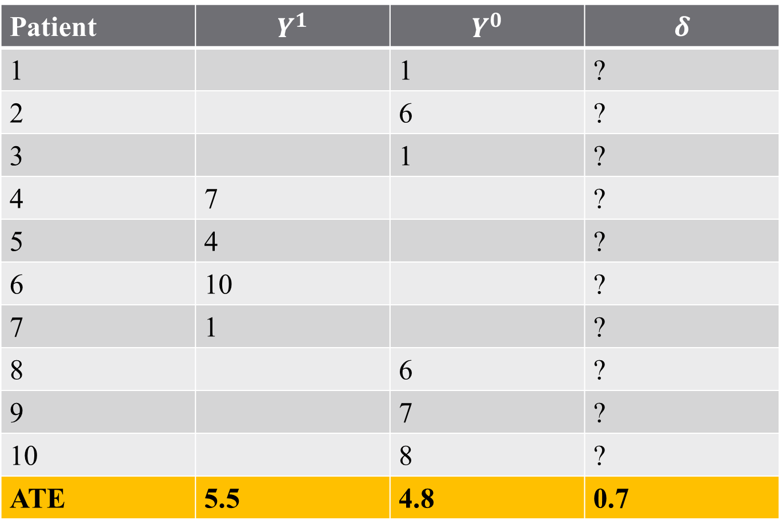
But what do we actually observe?
Patient | $$Y^{1}$$ | $$Y^{0}$$ | $$δ$$
1 |  | 1 | ?
2 |  | 6 | ?
3 |  | 1 | ?
4 | 7 |  | ?
5 | 4 |  | ?
6 | 10 |  | ?
7 | 1 |  | ?
8 |  | 6 | ?
9 |  | 7 | ?
10 |  | 8 | ?
ATE | 5.5 | 4.8 | 0.7
Notes:
Using Excel to randomly assign to treatment and control groups – not bad

Slide 67
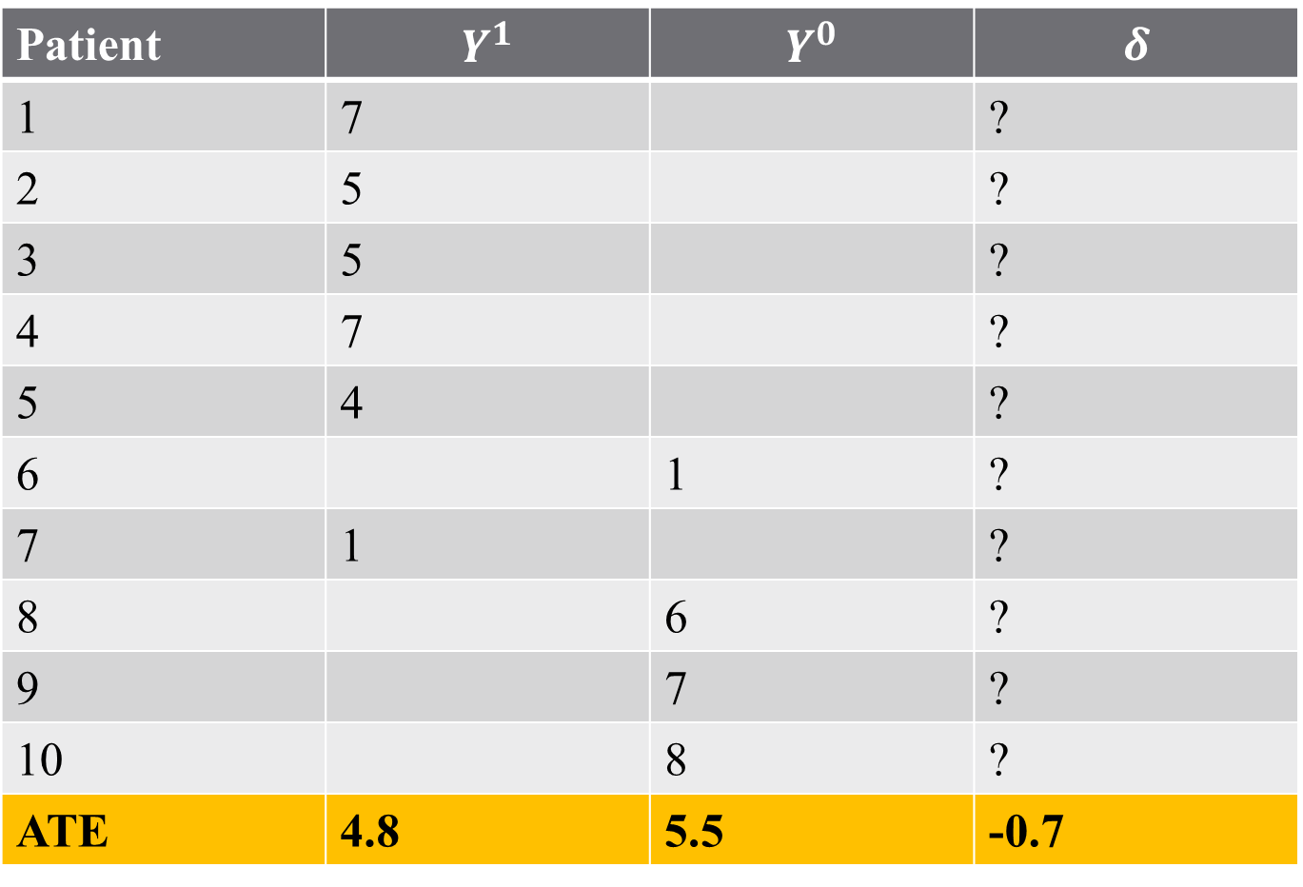
But what do we actually observe?
Patient | $$Y^{1}$$ | $$Y^{0}$$ | $$δ$$
1 | 7 |  | ?
2 | 5 |  | ?
3 | 5 |  | ?
4 | 7 |  | ?
5 | 4 |  | ?
6 |  | 1 | ?
7 | 1 |  | ?
8 |  | 6 | ?
9 |  | 7 | ?
10 |  | 8 | ?
ATE | 4.8 | 5.5 | -0.7
Notes:
Using Excel to randomly assign to treatment and control groups – now this is the exact opposite? Why might this happen? When do we know if this is a good estimator? We want (1) unbiasedness and (2) consistency.
Importantly in real world data, which of the assumptions that we just mentioned is going to be violated? Selection!

Slide 68
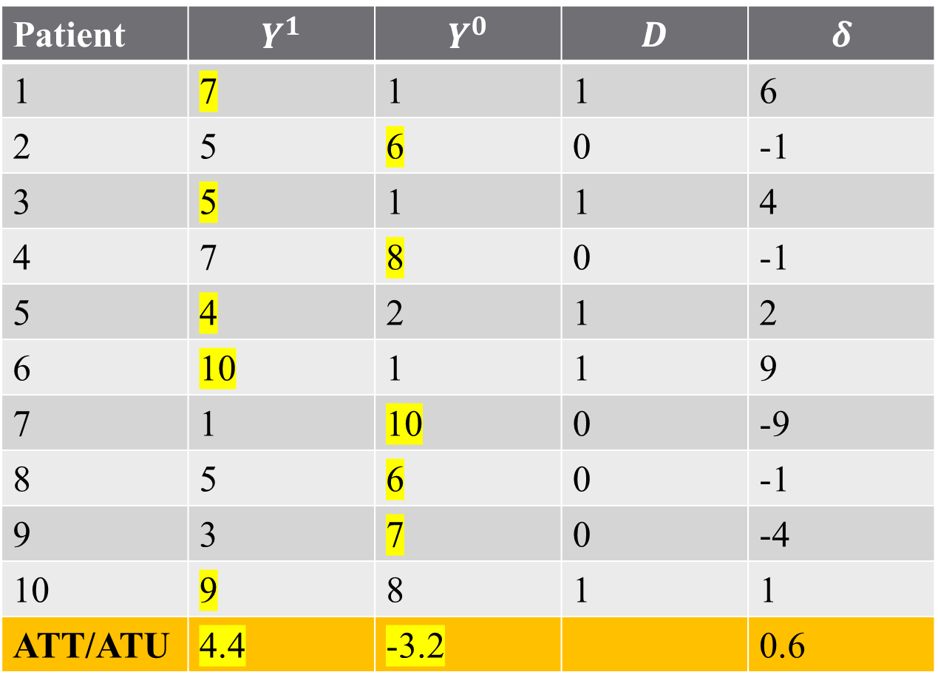
Example: Treatment Outcomes
Imagine a “perfect doctor” assigns best treatment available:
Patient | $$Y^{1}$$ | $$Y^{0}$$ | $$D$$ | $$δ$$
1 | 7 | 1 | 1 | 6
2 | 5 | 6 | 0 | -1
3 | 5 | 1 | 1 | 4
4 | 7 | 8 | 0 | -1
5 | 4 | 2 | 1 | 2
6 | 10 | 1 | 1 | 9
7 | 1 | 10 | 0 | -9
8 | 5 | 6 | 0 | -1
9 | 3 | 7 | 0 | -4
10 | 9 | 8 | 1 | 1
ATT/ATU | 4.4 | -3.2 |  | 0.6
Notes:
Here, the treatment is still based on the oracle, but now it’s oracle, MD. Why are these the same as the ATT and the ATU?

Slide 69
Example: Treatment Outcomes
Imagine a “perfect doctor” assigns best treatment available:
Patient | $$Y^{1}$$ | $$Y^{0}$$ | $$D$$ | $$δ$$
1 | 7 | 1 | 1 | 6
2 | 5 | 6 | 0 | -1
3 | 5 | 1 | 1 | 4
4 | 7 | 8 | 0 | -1
5 | 4 | 2 | 1 | 2
6 | 10 | 1 | 1 | 9
7 | 1 | 10 | 0 | -9
8 | 5 | 6 | 0 | -1
9 | 3 | 7 | 0 | -4
10 | 9 | 8 | 1 | 1
ATT/ATU | 4.4 | -3.2 |  | 0.6
The ATE is the weighted average of the ATT and ATU!
Notes:
To calculate, average delta across treated group and untreated group separately. Notice that the untreated units all would lose out from treatment (because they are perfectly assigned). Why are these the same as the ATT and the ATU?
Now what are the problems with this assignment? Violates independence!

Slide 70
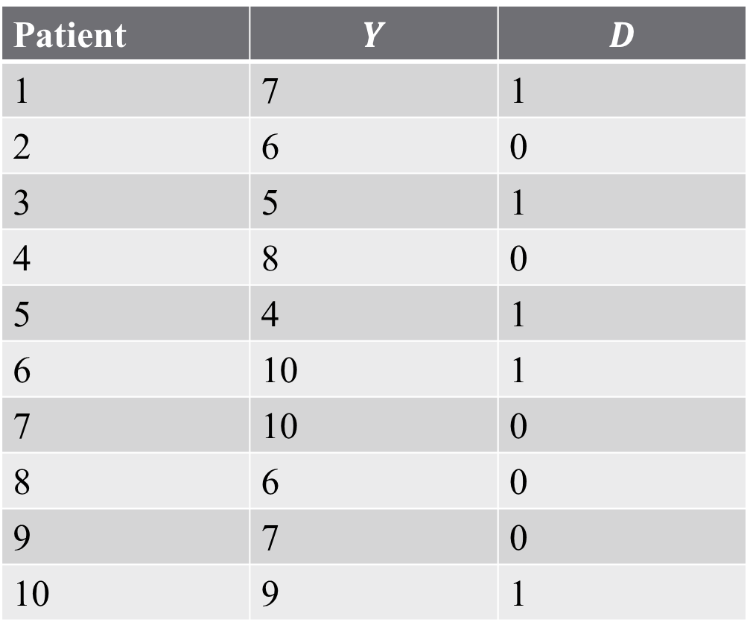
Example: Treatment Outcomes
Problem: We don’t observe two states for each individual!
Can we estimate the ATE?
Patient | $$Y$$ | $$D$$
1 | 7 | 1
2 | 6 | 0
3 | 5 | 1
4 | 8 | 0
5 | 4 | 1
6 | 10 | 1
7 | 10 | 0
8 | 6 | 0
9 | 7 | 0
10 | 9 | 1
How can we estimate the ATE?
Notes:
Okay, so now get to reality: no oracle. Does averaging work? Note – before, we weren’t talking about “estimating” the ATE because we had all data. Now, we are inherently using a sample even if we had population data.

Slide 71
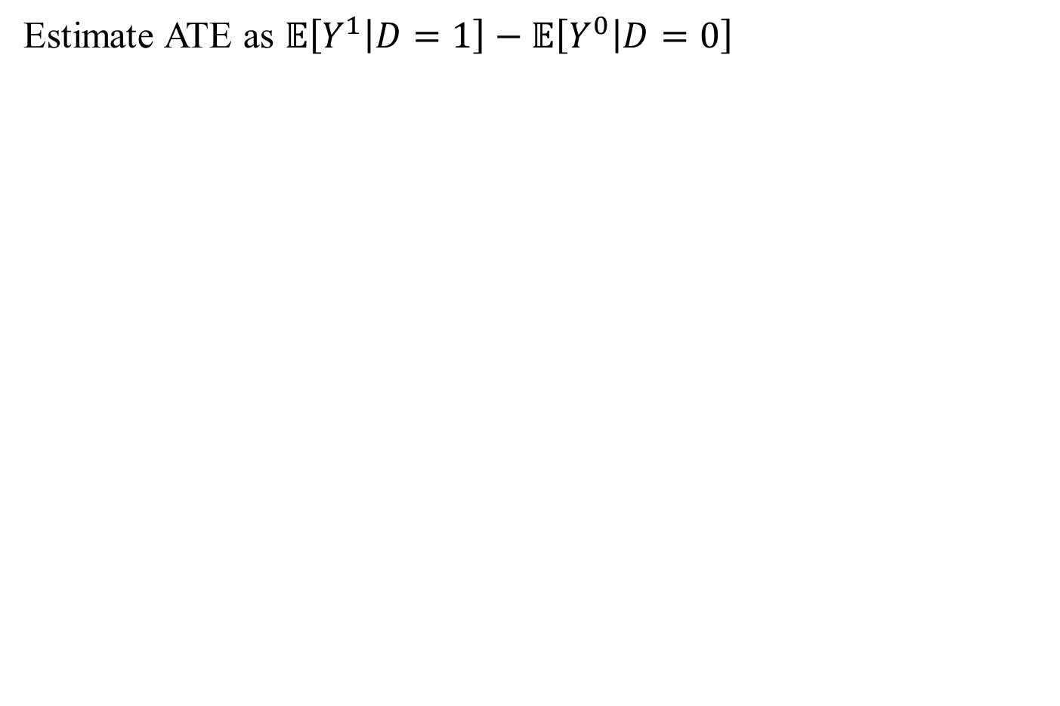
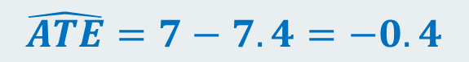
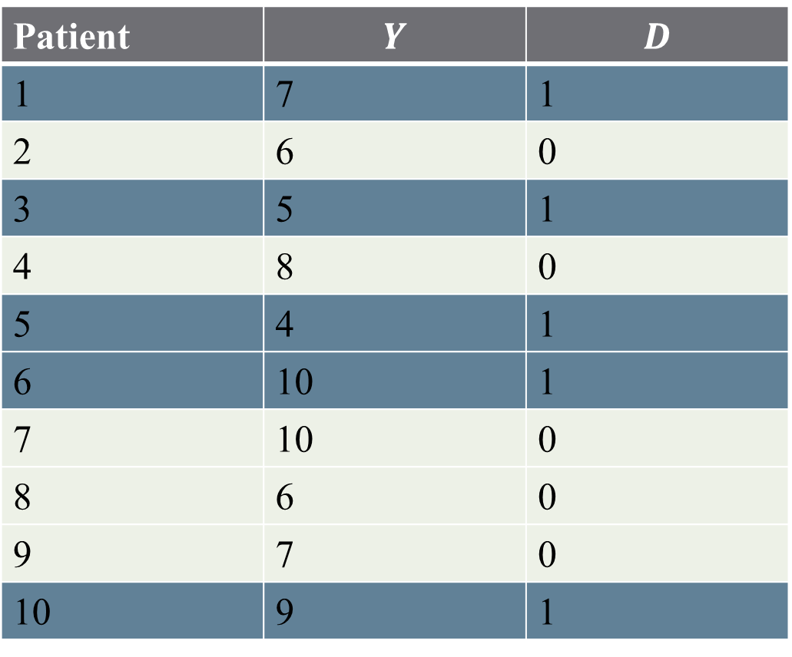
Example: Treatment Outcomes
Estimate ATE as $𝔼\left[Y^{1} | D=1\right]−𝔼\left[Y^{0} | D=0\right]$
Patient | $$Y$$ | $$D$$
1 | 7 | 1
2 | 6 | 0
3 | 5 | 1
4 | 8 | 0
5 | 4 | 1
6 | 10 | 1
7 | 10 | 0
8 | 6 | 0
9 | 7 | 0
10 | 9 | 1
$$\hat{ATE}=7−7.4=−0.4$$
Notes:
When do we know if this is a good estimator? We want (1) unbiasedness and (2) consistency.

Slide 72
Estimating an ATE
What does the estimated ATE mean?
Does this mean surgery has a negative effect?
Notes:
Now the econometrics comes in (more than just the math and stats)

Slide 73
Estimating an ATE
What does the estimated ATE mean?
Does this mean surgery has a negative effect?
This statistic is itself a random variable – need sufficient data/power to say that something is strongly different from 0 (noise)
This statistic might also suffer from “selection bias” (how?)
This is why assumptions are so important for econometrics!
Notes:
Here, the selection is who got the treatment – sicker patients get surgery, this changes the underlying nature of our data set. Treatment is not independently assigned (in DAG language? This is confounding)

Slide 74
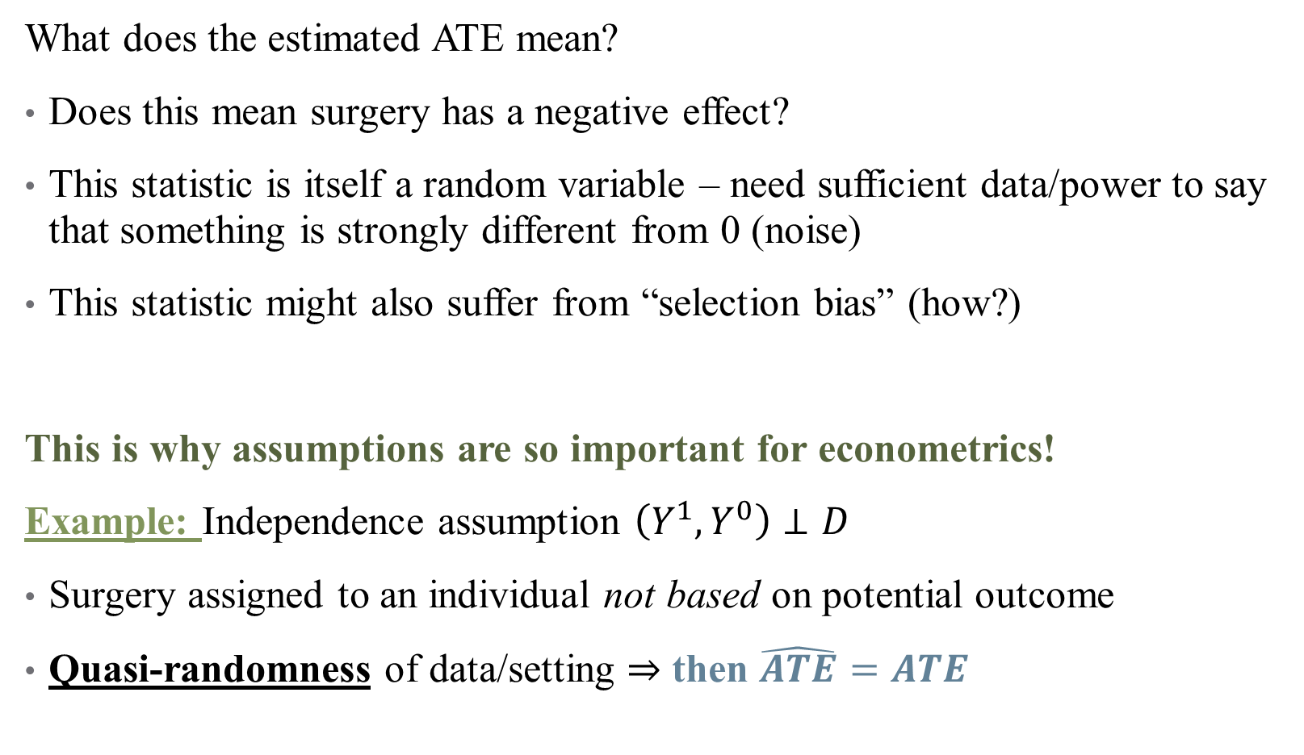
Estimating an ATE
What does the estimated ATE mean?
Does this mean surgery has a negative effect?
This statistic is itself a random variable – need sufficient data/power to say that something is strongly different from 0 (noise)
This statistic might also suffer from “selection bias” (how?)
This is why assumptions are so important for econometrics!
Example: Independence assumption $\left(Y^{1},Y^{0}\right)⊥D$
Surgery assigned to an individual not based on potential outcome
Quasi-randomness of data/setting $⇒$ then $\hat{ATE}=ATE$
Notes:
This is why simple differences in means don’t capture causality! What do we mean by quasi-randomness (from the reading)?

Slide 75
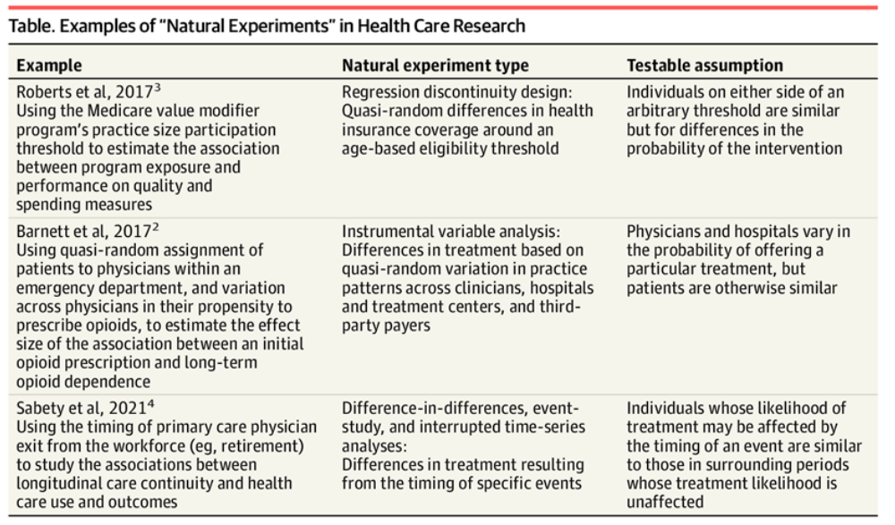
Some Types of Natural Experiments
Notes:
What stood out here? What was compelling? What made you scratch your head and say “that can’t be true”? (Can use other examples from the reading – but let’s focus on the exogenous variation we are using).

Slide 76
Why DAGs and PO?
DAGs are much more common in fields like epidemiology. PO frameworks are much mor common in fields like economics. Why?
Some (Pearl) have argued that the two fields study similar problems in terms of number of variables, types of data, and nature of research questions. This is definitely truer if you look at health economists!
But the two fields have one huge difference: human behavior. What does this mean for data structures?
Notes:
With great power, great responsibility

Slide 77
Why DAGs and PO?
DAGs are much more common in fields like epidemiology. PO frameworks are much mor common in fields like economics. Why?
Some (Pearl) have argued that the two fields study similar problems in terms of number of variables, types of data, and nature of research questions. This is definitely truer if you look at health economists!
But the two fields have one huge difference: human behavior. What does this mean for data structures?
DAGs might be useful for you if you are doing: prediction, multiple causal pathways affecting a single static outcome, or have a strong sense of how the DGP is structured.
POs are likely more useful if you care about policy manipulation (pre-/post-treatment differences), general equilibrium effects (simultaneity) or if you are worried about selection/endogeneity affecting your identification.
Notes:
With great power, great responsibility

Slide 78
A final example
Consider a sort of prototypical question (we will come back to this one): how does education affect your earnings?
Education
Earnings
Notes:
Drawn from Imbens’ paper. What observed cofounders exist? What unobserved variables might confound this?

Slide 79
A final example
Consider a sort of prototypical question (we will come back to this one): how does education affect your earnings?
Education
Earnings
Ability
Notes:
This is the value of DAGs, we can draw these easily! But how can we deal with this?

Slide 80
A final example
Consider a sort of prototypical question (we will come back to this one): how does education affect your earnings?
Quarter of Birth
Education
Earnings
Ability
Distance to College
Education
Earnings
Ability
Notes:
Here are two possible approaches – both are instrumental varaibles approaches (we will cover these later) and find something correlated with the exposure but not with the unobserved confounder. But the DAG doesn’t tell us all of the assumptions here, or the differences between these two models? They should return the same treatment effect, right? Maybe, maybe not! This is where the PO model can be more useful.

Slide 81
Model Testing
Model testing is not looking for evidence for your preferred model
It is easy to find evidence in support of your model
Especially when you developed the model after looking at the data
You should report tests that try to prove that your model is wrong.
https://projects.fivethirtyeight.com/p-hacking/
Notes:
Some notes on model testing. Confirmation and publication biases abound in literature. You can believe in your hypothesis and do a project that tests it (this is part of the scientific method!) but you should just as earnestly try to disprove it (that’s how you know your DAG is wrong, for example). Science should be about knowledge , not politics or storytelling. Use the data hacking website if you have time.

Slide 82
Concluding thoughts
Econometrics is powerful, but must be applied carefully
There are no shortcuts to analyzing health data.
We must:
Consider all reasonable DGPs
Formulate as many models as we can
Make sure that we understand the implications of the structure
Test the model against the data
Hunt for flaws in it.
Only when we have done all of that can we gain confidence in our findings
Notes:
With great power, great responsibility

Slide 83
Concluding thoughts
Econometrics is powerful, but must be applied carefully
There are no shortcuts to analyzing health data.
We must:
Consider all reasonable DGPs
Formulate as many models as we can
Make sure that we understand the implications of the structure
Test the model against the data
Hunt for flaws in it.
Only when we have done all of that can we gain confidence in our findings
Next time: intro to regression and associations
Notes:
Questions?

